Slide 1
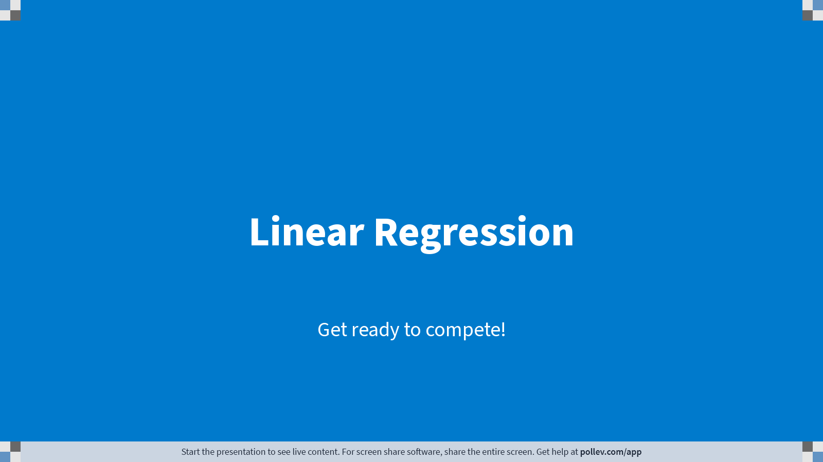
Notes:
Poll Title: Do not modify the notes in this section to avoid tampering with the Poll Everywhere activity. More info at polleverywhere.com/support Linear Regression https://www.polleverywhere.com/competitions/ll7dAKhMNsDwXB9Bsk5zY?display_state=welcome&controls=none&onscreen=persist

Slide 2
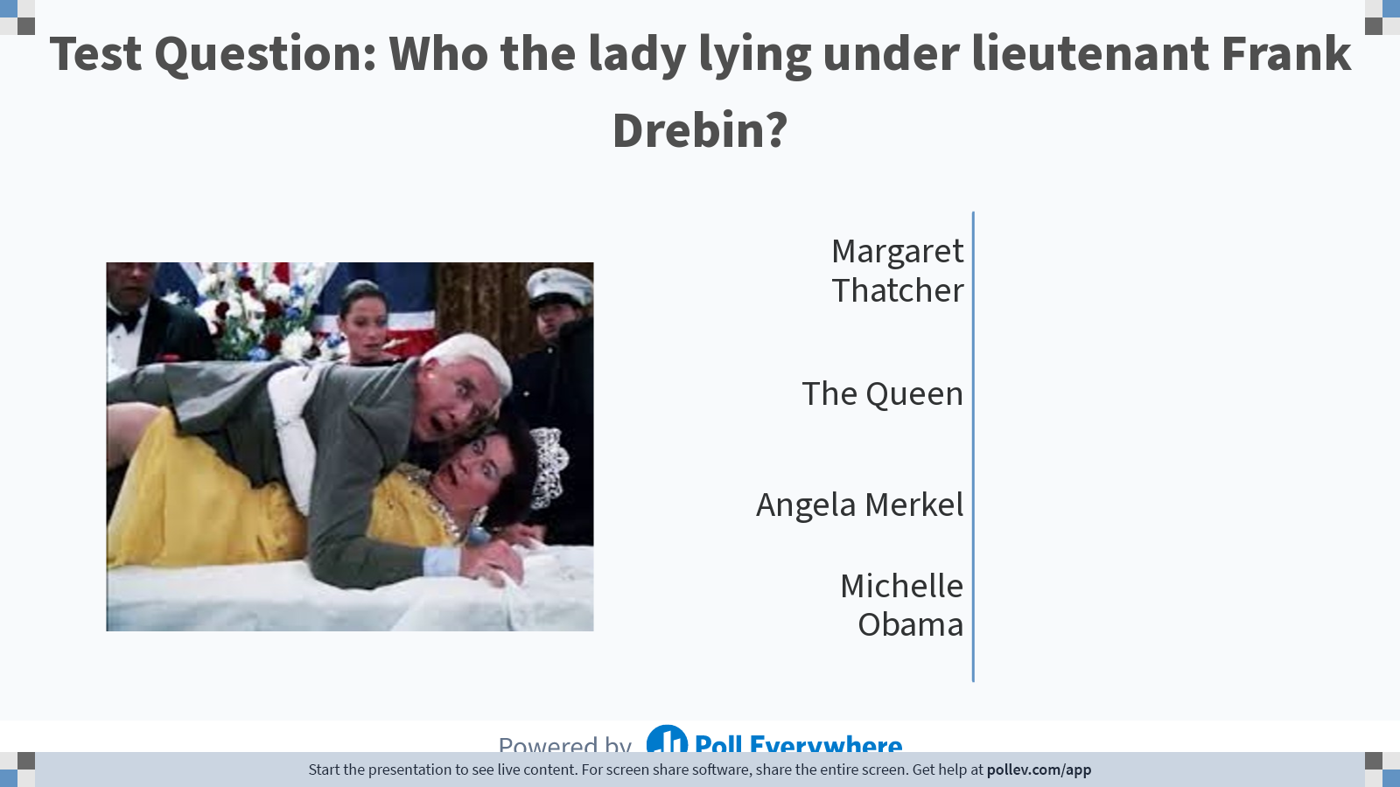
Notes:
Poll Title: Do not modify the notes in this section to avoid tampering with the Poll Everywhere activity. More info at polleverywhere.com/support Test Question: Who the lady lying under lieutenant Frank Drebin? https://www.polleverywhere.com/multiple_choice_polls/qa8mVmPWXjkFBF0VdOEeX?display_state=chart&activity_state=closed&state=closed&flow=Instructor&onscreen=persist

Slide 3
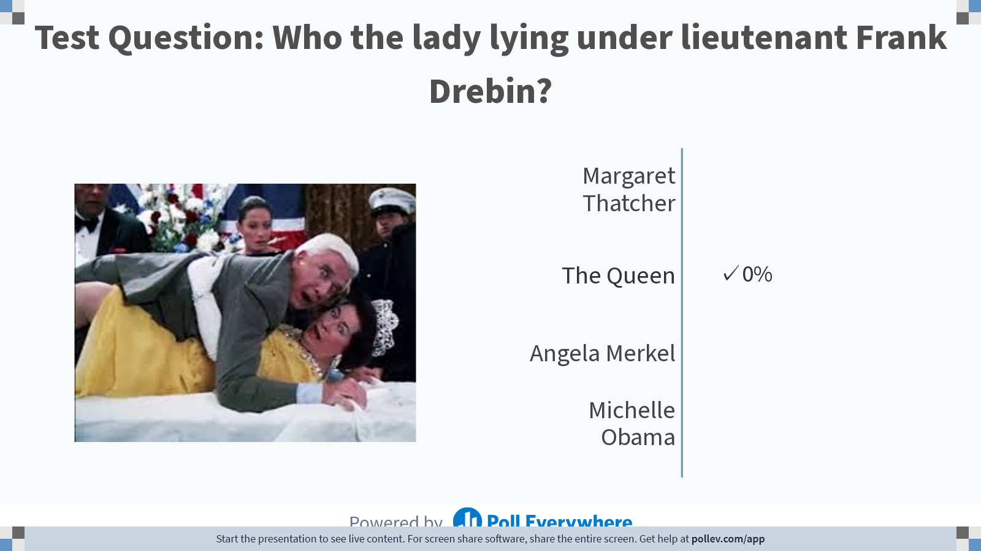
Notes:
Poll Title: Do not modify the notes in this section to avoid tampering with the Poll Everywhere activity. More info at polleverywhere.com/support Test Question: Who the lady lying under lieutenant Frank Drebin? https://www.polleverywhere.com/multiple_choice_polls/qa8mVmPWXjkFBF0VdOEeX?display_state=chart&activity_state=closed&display=correctness&state=closed&flow=Instructor&onscreen=persist

Slide 4
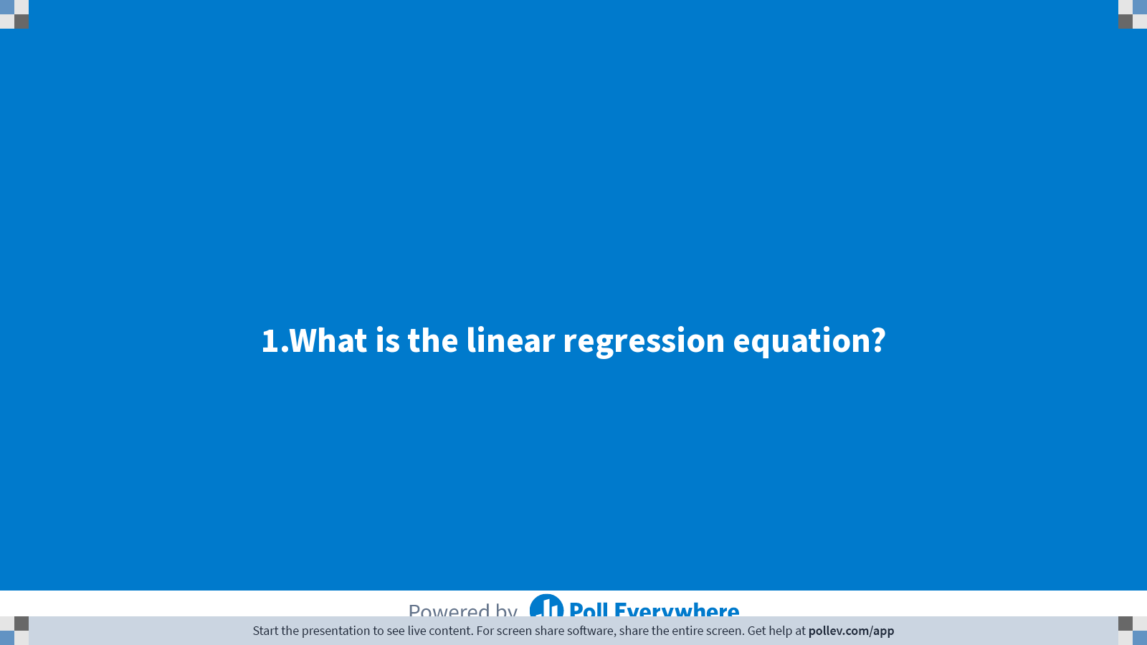
Notes:
Poll Title: Do not modify the notes in this section to avoid tampering with the Poll Everywhere activity. More info at polleverywhere.com/support 1.What is the linear regression equation? https://www.polleverywhere.com/multiple_choice_polls/MfmtszuivbE7koXJP3elH?display_state=title&controls=none&onscreen=persist

Slide 5
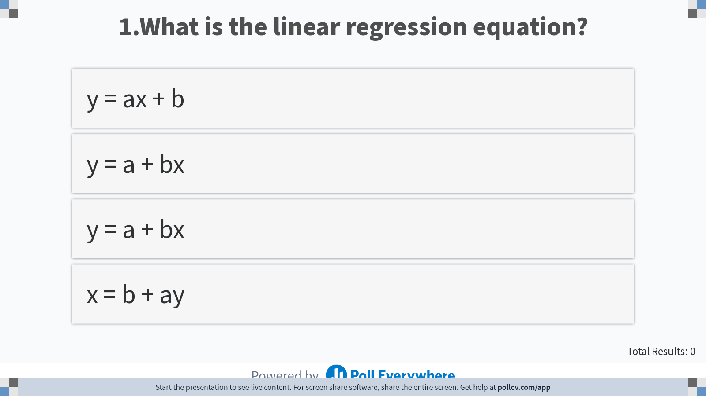
Notes:
Poll Title: Do not modify the notes in this section to avoid tampering with the Poll Everywhere activity. More info at polleverywhere.com/support 1.What is the linear regression equation? https://www.polleverywhere.com/multiple_choice_polls/MfmtszuivbE7koXJP3elH?display_state=instructions&controls=none&onscreen=persist

Slide 6
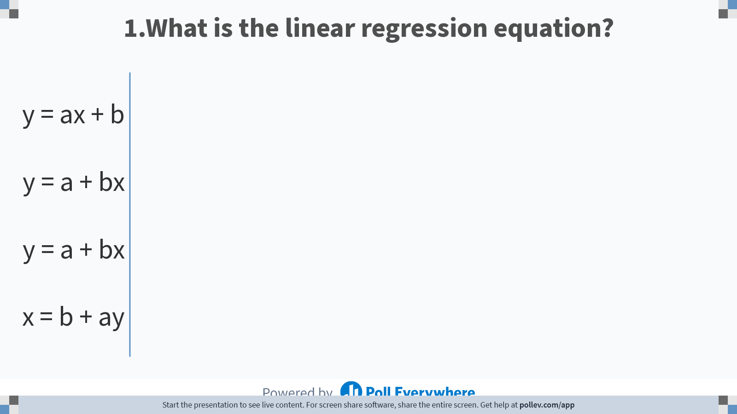
Notes:
Poll Title: Do not modify the notes in this section to avoid tampering with the Poll Everywhere activity. More info at polleverywhere.com/support 1.What is the linear regression equation? https://www.polleverywhere.com/multiple_choice_polls/MfmtszuivbE7koXJP3elH?display_state=chart&display=correctness&controls=none&onscreen=persist

Slide 7
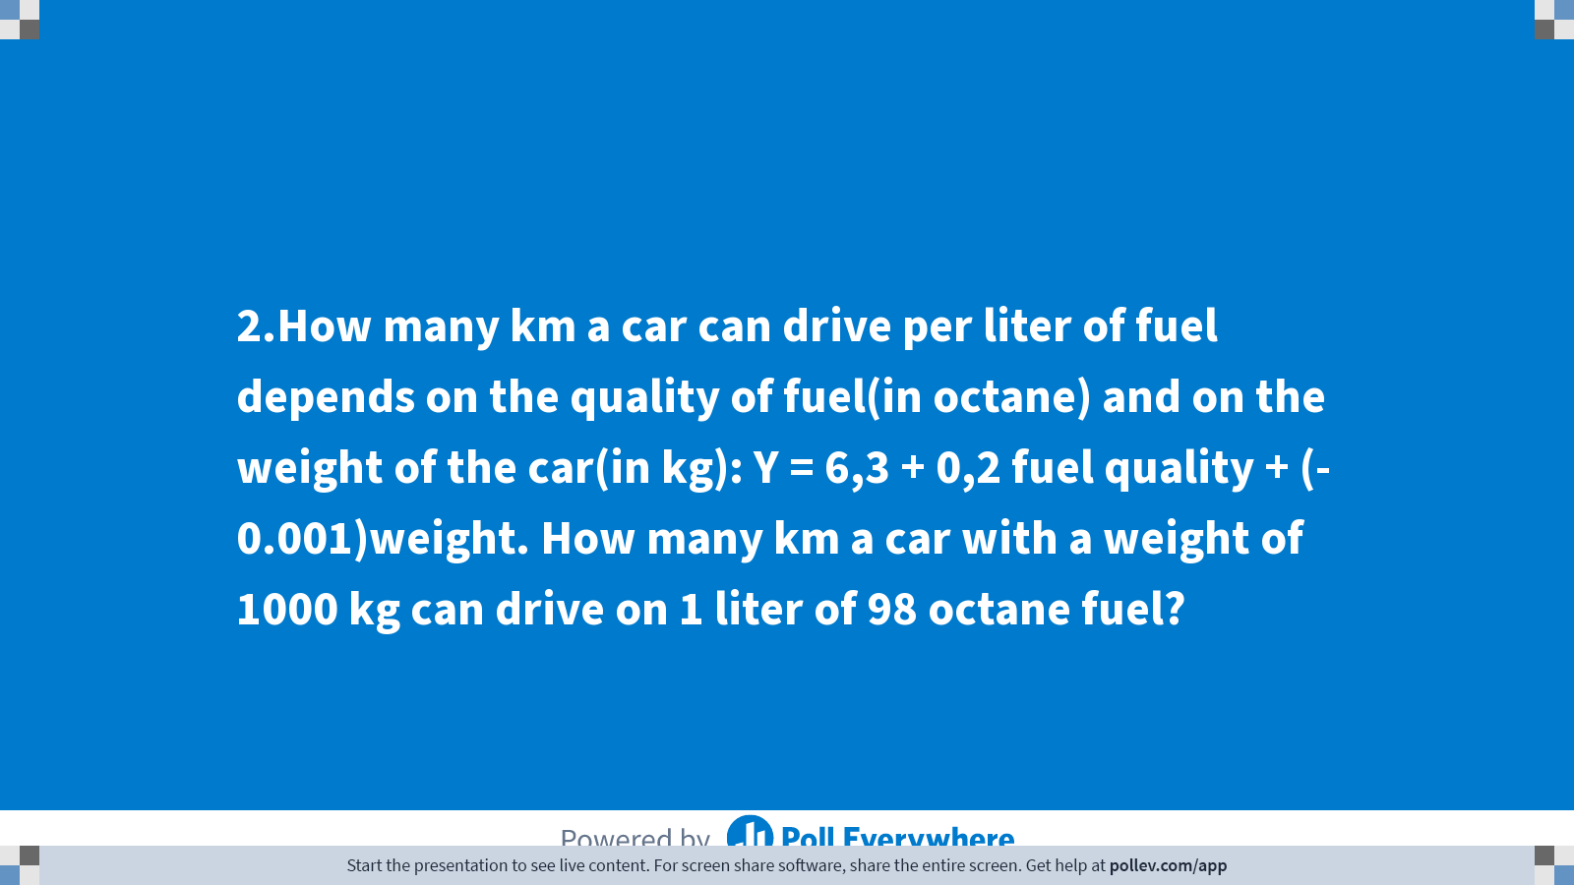
Notes:
Poll Title: Do not modify the notes in this section to avoid tampering with the Poll Everywhere activity. More info at polleverywhere.com/support 2.How many km a car can drive per liter of fuel depends on the quality of fuel(in octane) and on the weight of the car(in kg): Y = 6,3 + 0,2 fuel quality + (- 0.001)weight. How many km a car with a weight of 1000 kg can drive on 1 liter of 98 octane fuel? https://www.polleverywhere.com/multiple_choice_polls/YLhVAh9niFLfXetp8tf2h?display_state=title&controls=none&onscreen=persist

Slide 8
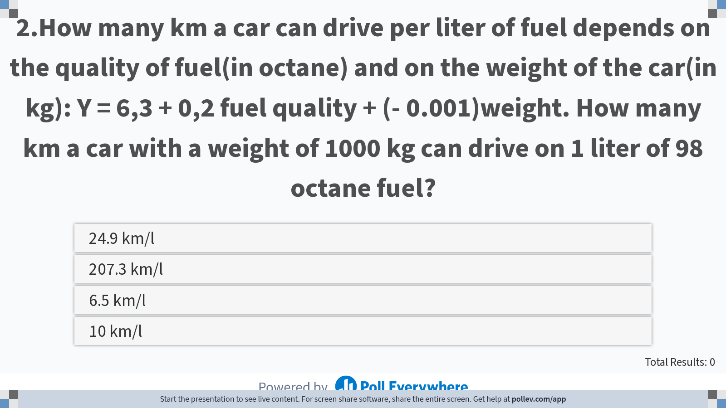
Notes:
Quality (octane) 98
Weigh (Kg) 1000
6.3 + 0.2(98) -1
5.3 + 19.6
7.
Poll Title: Do not modify the notes in this section to avoid tampering with the Poll Everywhere activity. More info at polleverywhere.com/support 2.How many km a car can drive per liter of fuel depends on the quality of fuel(in octane) and on the weight of the car(in kg): Y = 6,3 + 0,2 fuel quality + (- 0.001)weight. How many km a car with a weight of 1000 kg can drive on 1 liter of 98 octane fuel? https://www.polleverywhere.com/multiple_choice_polls/YLhVAh9niFLfXetp8tf2h?display_state=instructions&controls=none&onscreen=persist

Slide 9
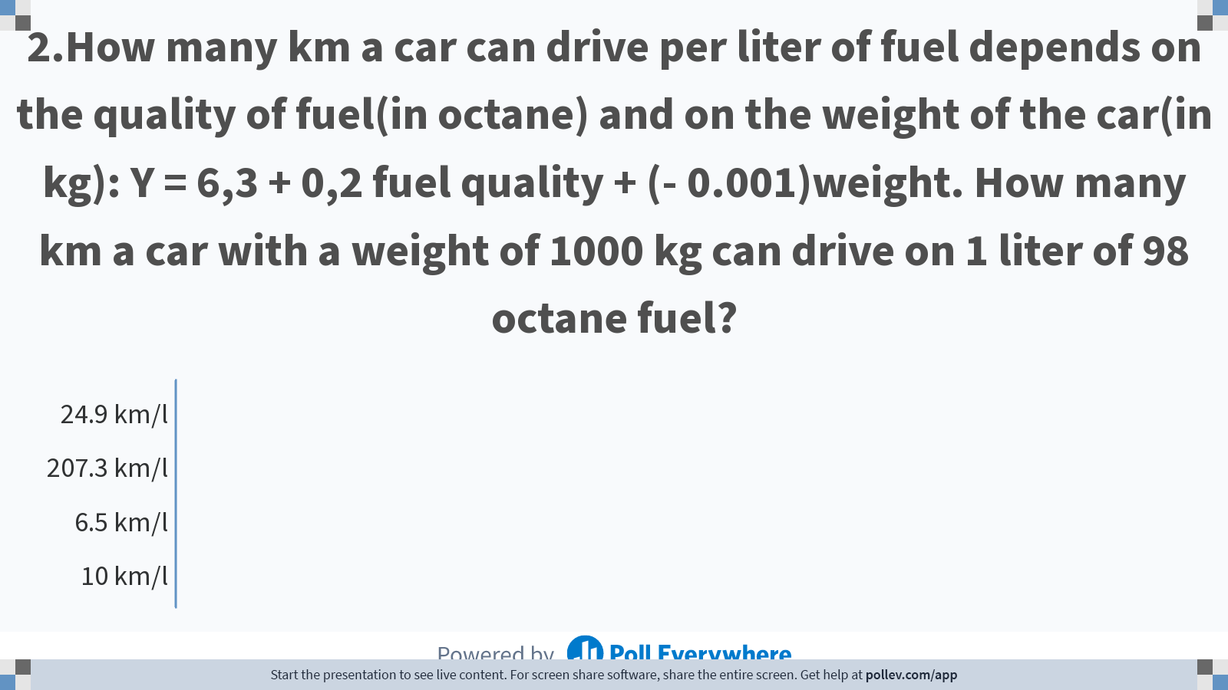
Notes:
Poll Title: Do not modify the notes in this section to avoid tampering with the Poll Everywhere activity. More info at polleverywhere.com/support 2.How many km a car can drive per liter of fuel depends on the quality of fuel(in octane) and on the weight of the car(in kg): Y = 6,3 + 0,2 fuel quality + (- 0.001)weight. How many km a car with a weight of 1000 kg can drive on 1 liter of 98 octane fuel? https://www.polleverywhere.com/multiple_choice_polls/YLhVAh9niFLfXetp8tf2h?display_state=chart&display=correctness&controls=none&onscreen=persist

Slide 10
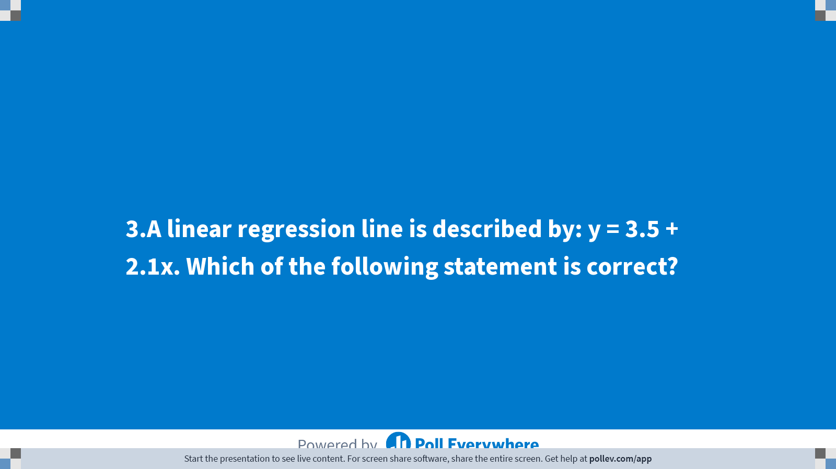
Notes:
Poll Title: Do not modify the notes in this section to avoid tampering with the Poll Everywhere activity. More info at polleverywhere.com/support 3.A linear regression line is described by: y = 3.5 + 2.1x. Which of the following statement is correct? https://www.polleverywhere.com/multiple_choice_polls/kVgTxbKzrKWrlUq9eume0?display_state=title&controls=none&onscreen=persist

Slide 11
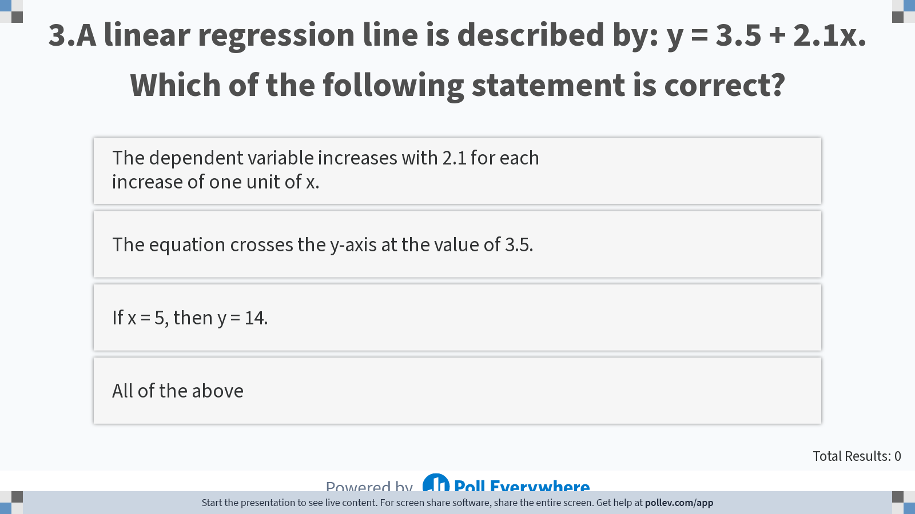
Notes:
Poll Title: Do not modify the notes in this section to avoid tampering with the Poll Everywhere activity. More info at polleverywhere.com/support 3.A linear regression line is described by: y = 3.5 + 2.1x. Which of the following statement is correct? https://www.polleverywhere.com/multiple_choice_polls/kVgTxbKzrKWrlUq9eume0?display_state=instructions&controls=none&onscreen=persist

Slide 12
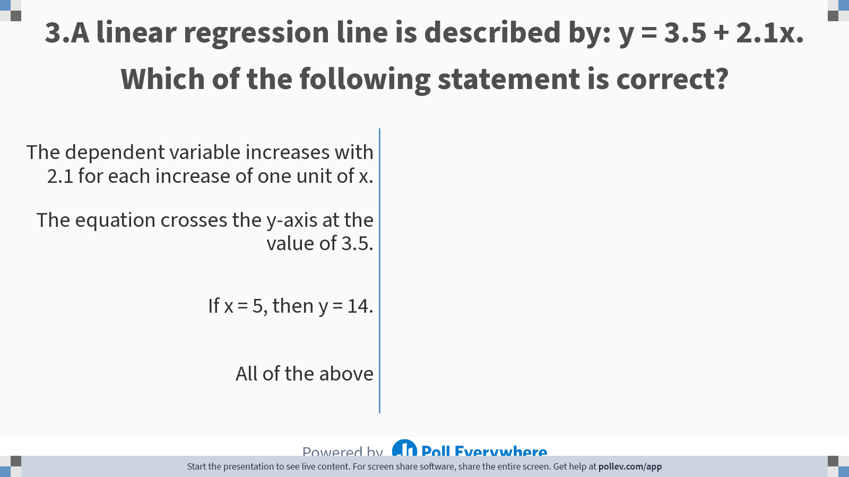
Notes:
Poll Title: Do not modify the notes in this section to avoid tampering with the Poll Everywhere activity. More info at polleverywhere.com/support 3.A linear regression line is described by: y = 3.5 + 2.1x. Which of the following statement is correct? https://www.polleverywhere.com/multiple_choice_polls/kVgTxbKzrKWrlUq9eume0?display_state=chart&display=correctness&controls=none&onscreen=persist

Slide 13
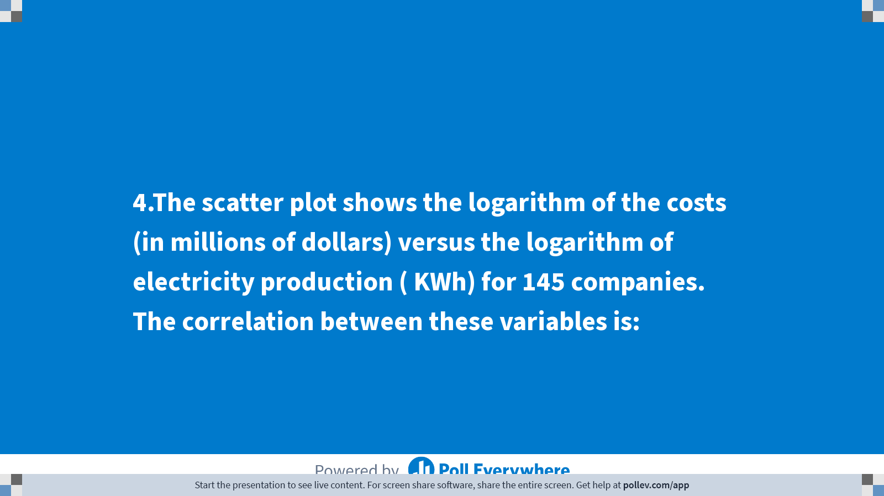
Notes:
Poll Title: Do not modify the notes in this section to avoid tampering with the Poll Everywhere activity. More info at polleverywhere.com/support 4.The scatter plot shows the logarithm of the costs (in millions of dollars) versus the logarithm of electricity production ( KWh) for 145 companies. The correlation between these variables is: https://www.polleverywhere.com/multiple_choice_polls/rlQUpkphagAs1CURHToO0?display_state=title&controls=none&onscreen=persist

Slide 14
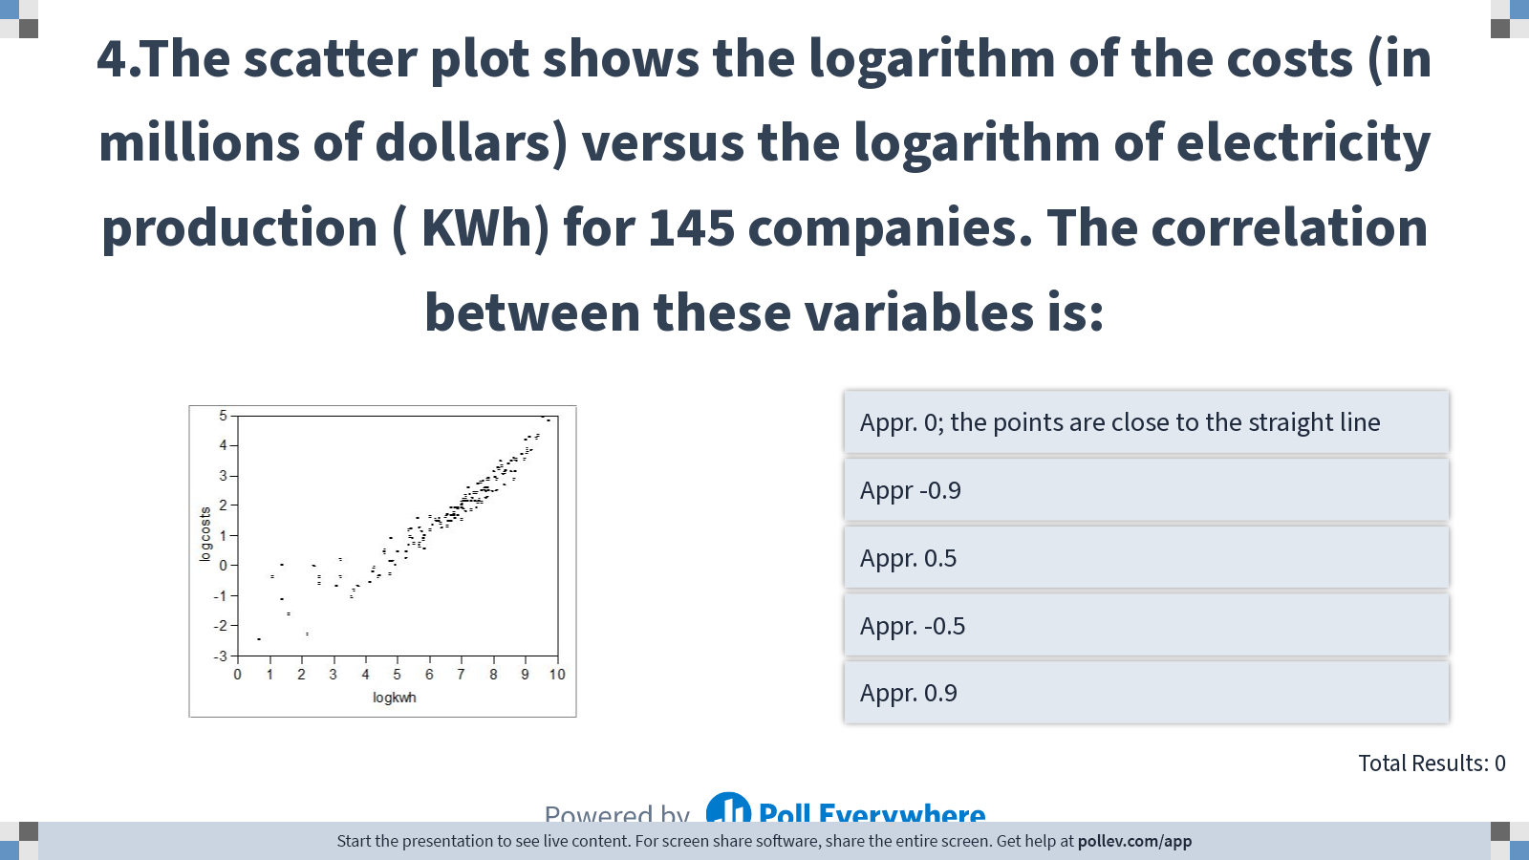
Notes:
Poll Title: Do not modify the notes in this section to avoid tampering with the Poll Everywhere activity. More info at polleverywhere.com/support 4.The scatter plot shows the logarithm of the costs (in millions of dollars) versus the logarithm of electricity production ( KWh) for 145 companies. The correlation between these variables is: https://www.polleverywhere.com/multiple_choice_polls/rlQUpkphagAs1CURHToO0?display_state=instructions&controls=none&onscreen=persist

Slide 15
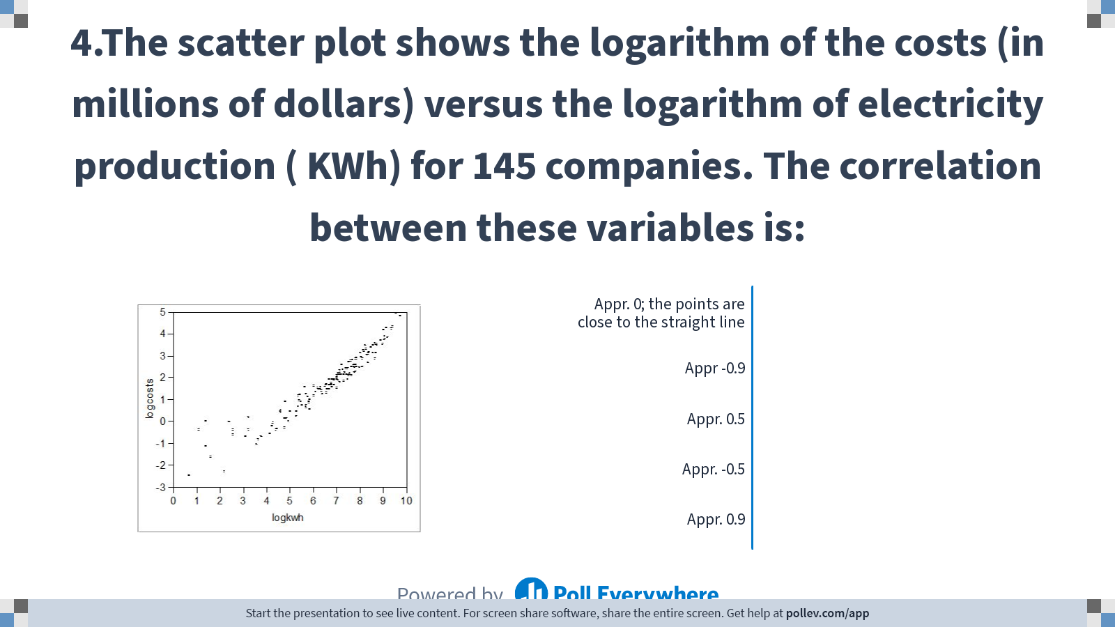
Notes:
Poll Title: Do not modify the notes in this section to avoid tampering with the Poll Everywhere activity. More info at polleverywhere.com/support 4.The scatter plot shows the logarithm of the costs (in millions of dollars) versus the logarithm of electricity production ( KWh) for 145 companies. The correlation between these variables is: https://www.polleverywhere.com/multiple_choice_polls/rlQUpkphagAs1CURHToO0?display_state=chart&display=correctness&controls=none&onscreen=persist

Slide 16
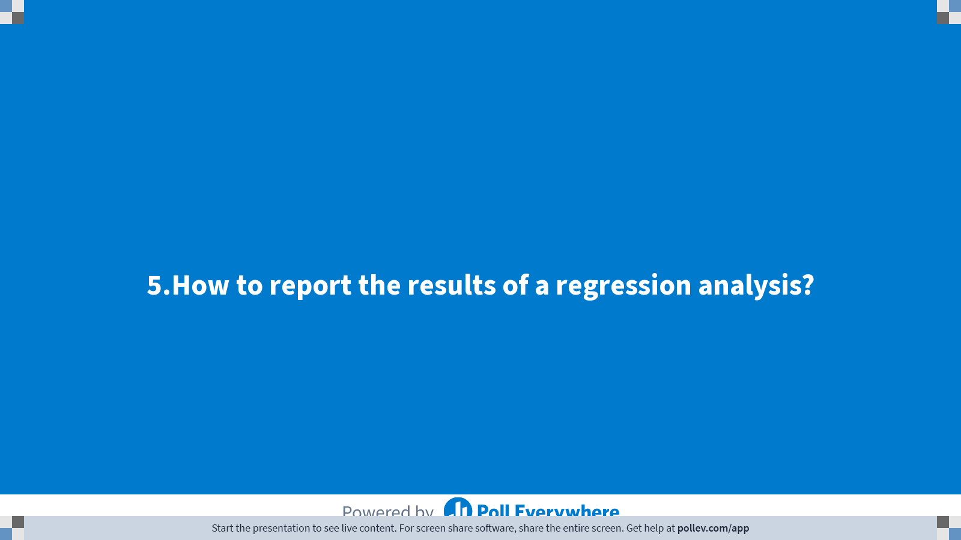
Notes:
Poll Title: Do not modify the notes in this section to avoid tampering with the Poll Everywhere activity. More info at polleverywhere.com/support 5.How to report the results of a regression analysis? https://www.polleverywhere.com/multiple_choice_polls/JUtSnNKIykH5OnDAWZxp6?display_state=title&controls=none&onscreen=persist

Slide 17
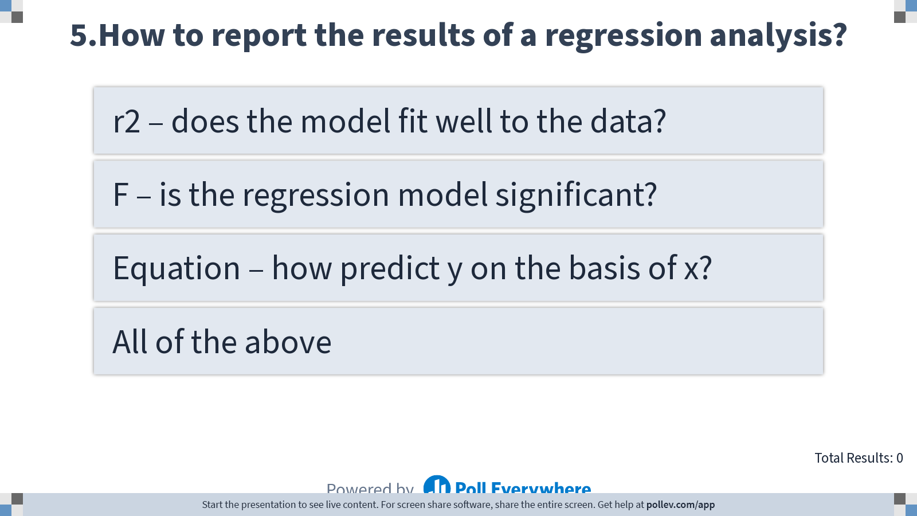
Notes:
Poll Title: Do not modify the notes in this section to avoid tampering with the Poll Everywhere activity. More info at polleverywhere.com/support 5.How to report the results of a regression analysis? https://www.polleverywhere.com/multiple_choice_polls/JUtSnNKIykH5OnDAWZxp6?display_state=instructions&controls=none&onscreen=persist

Slide 18
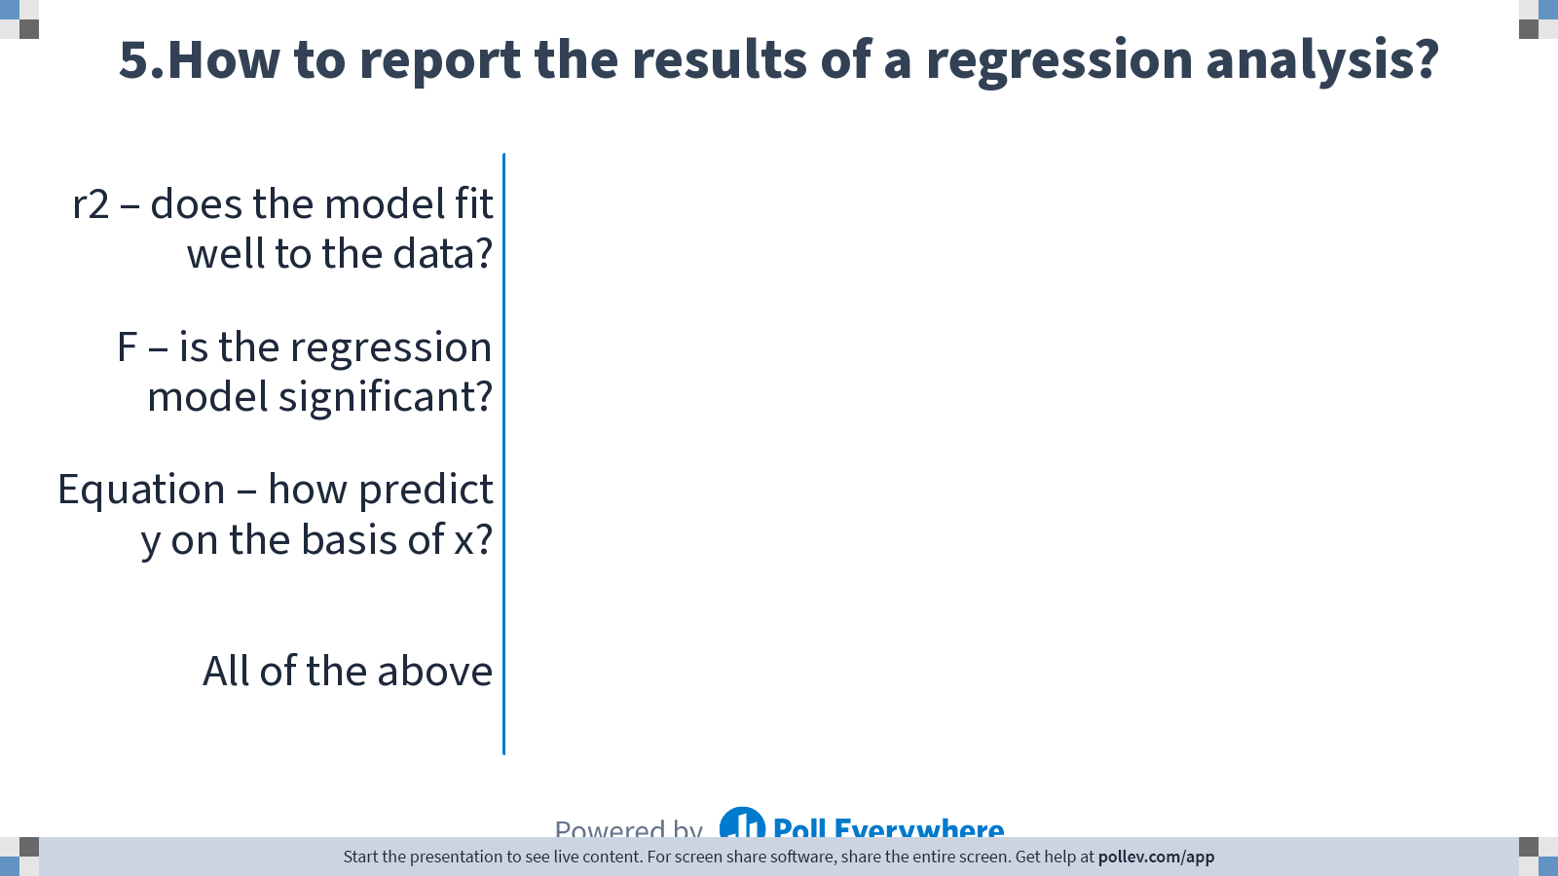
Notes:
Poll Title: Do not modify the notes in this section to avoid tampering with the Poll Everywhere activity. More info at polleverywhere.com/support 5.How to report the results of a regression analysis? https://www.polleverywhere.com/multiple_choice_polls/JUtSnNKIykH5OnDAWZxp6?display_state=chart&display=correctness&controls=none&onscreen=persist

Slide 19
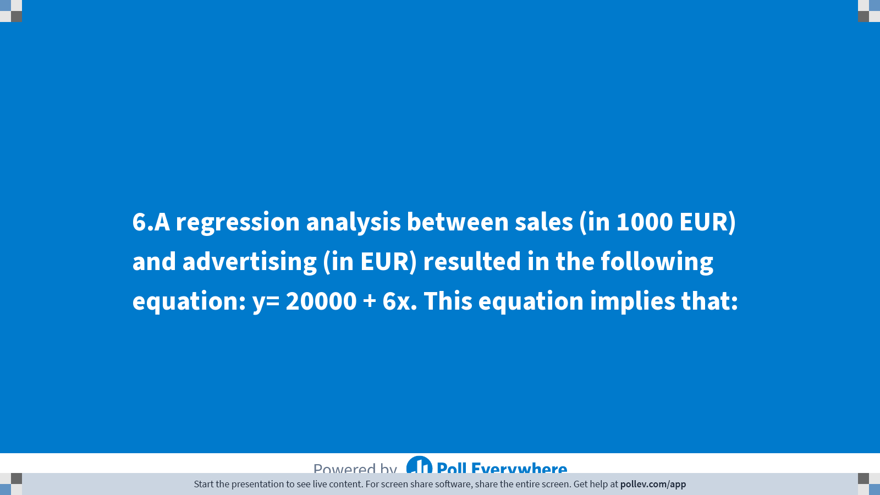
Notes:
Poll Title: Do not modify the notes in this section to avoid tampering with the Poll Everywhere activity. More info at polleverywhere.com/support 6.A regression analysis between sales (in 1000 EUR) and advertising (in EUR) resulted in the following equation: y= 20000 + 6x. This equation implies that: https://www.polleverywhere.com/multiple_choice_polls/rULKlsc5cuxxRcl0IcAEp?display_state=title&controls=none&onscreen=persist

Slide 20
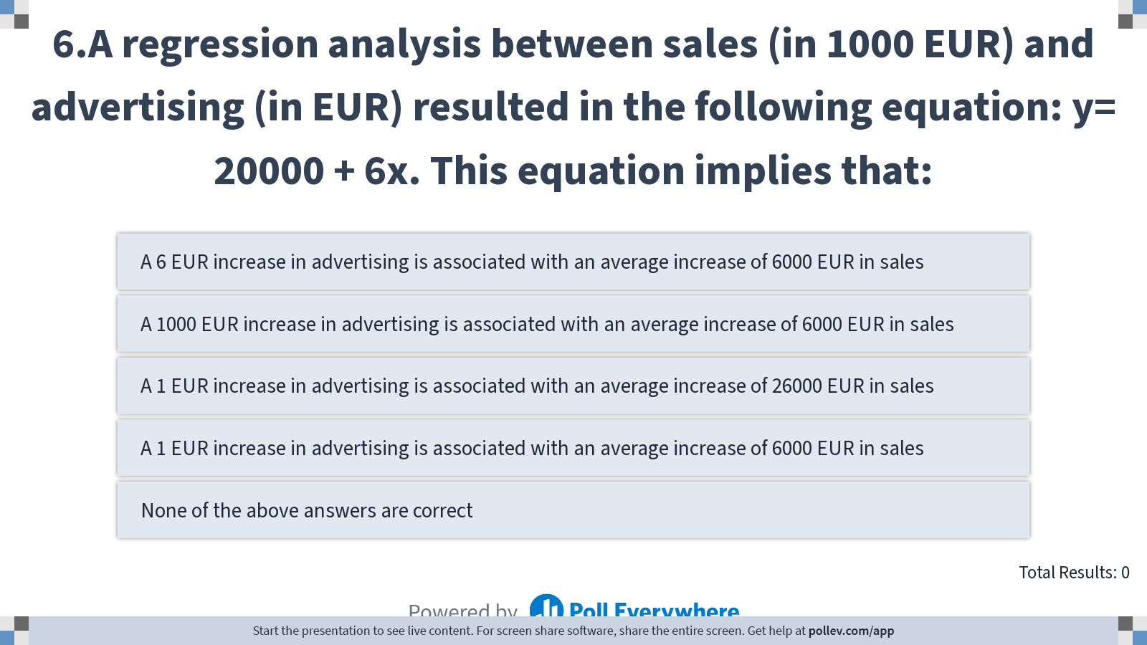
Notes:
Sales in 1000 EUR
Advertising in EUR
Y = 20000 + 6*1
Poll Title: Do not modify the notes in this section to avoid tampering with the Poll Everywhere activity. More info at polleverywhere.com/support 6.A regression analysis between sales (in 1000 EUR) and advertising (in EUR) resulted in the following equation: y= 20000 + 6x. This equation implies that: https://www.polleverywhere.com/multiple_choice_polls/rULKlsc5cuxxRcl0IcAEp?display_state=instructions&controls=none&onscreen=persist

Slide 21
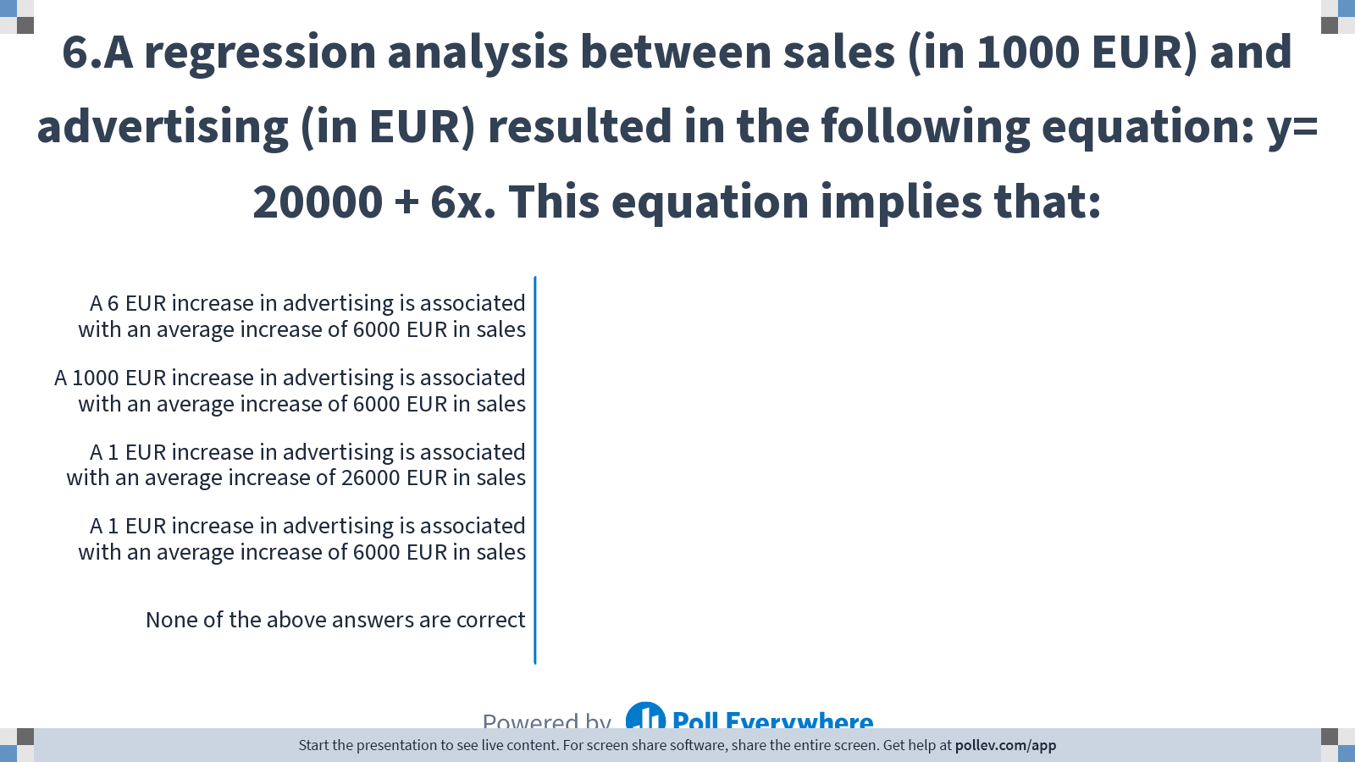
Notes:
Poll Title: Do not modify the notes in this section to avoid tampering with the Poll Everywhere activity. More info at polleverywhere.com/support 6.A regression analysis between sales (in 1000 EUR) and advertising (in EUR) resulted in the following equation: y= 20000 + 6x. This equation implies that: https://www.polleverywhere.com/multiple_choice_polls/rULKlsc5cuxxRcl0IcAEp?display_state=chart&display=correctness&controls=none&onscreen=persist

Slide 22
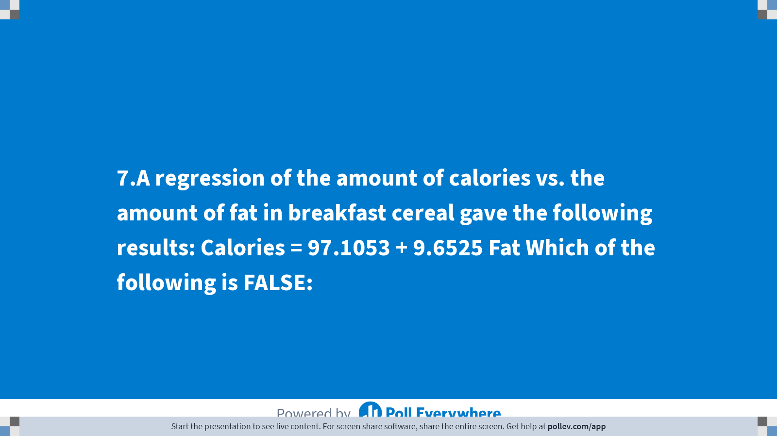
Notes:
Poll Title: Do not modify the notes in this section to avoid tampering with the Poll Everywhere activity. More info at polleverywhere.com/support 7.A regression of the amount of calories vs. the amount of fat in breakfast cereal gave the following results: Calories = 97.1053 + 9.6525 Fat Which of the following is FALSE: https://www.polleverywhere.com/multiple_choice_polls/BUHQdbYZKK7M0n5R7q43A?display_state=title&controls=none&onscreen=persist

Slide 23
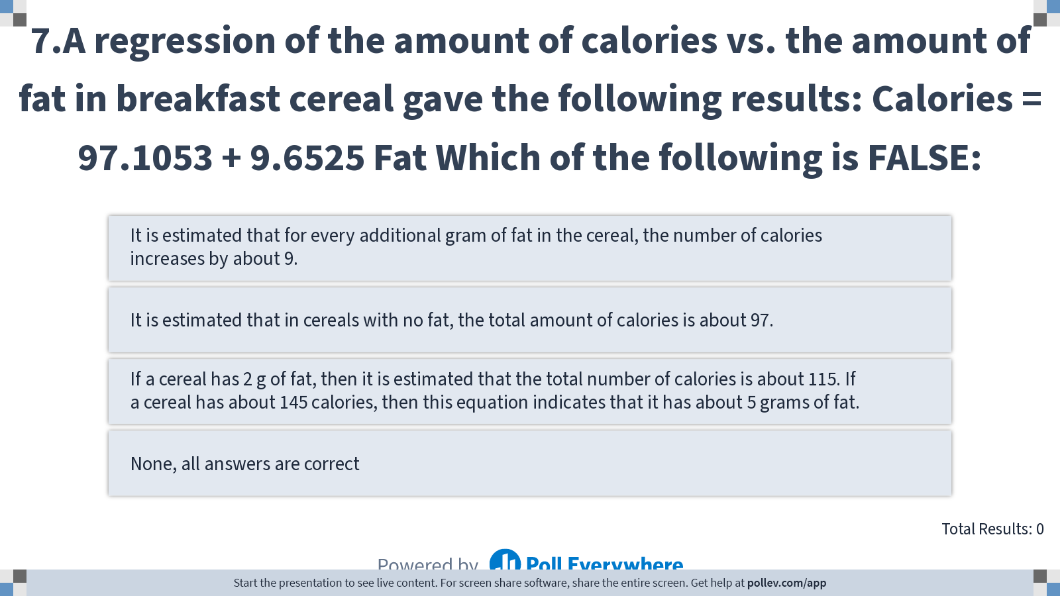
Notes:
Poll Title: Do not modify the notes in this section to avoid tampering with the Poll Everywhere activity. More info at polleverywhere.com/support 7.A regression of the amount of calories vs. the amount of fat in breakfast cereal gave the following results: Calories = 97.1053 + 9.6525 Fat Which of the following is FALSE: https://www.polleverywhere.com/multiple_choice_polls/BUHQdbYZKK7M0n5R7q43A?display_state=instructions&controls=none&onscreen=persist

Slide 24
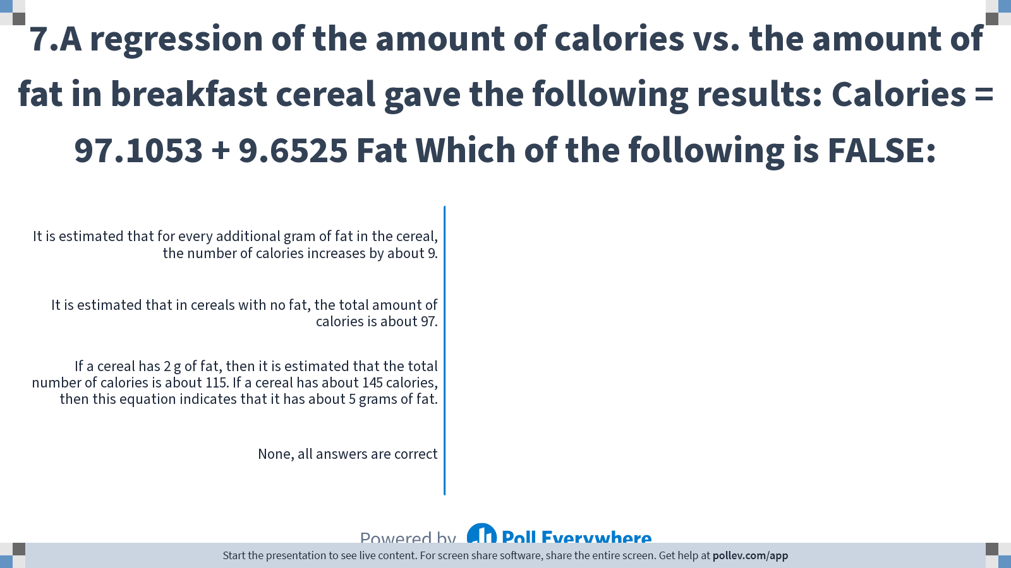
Notes:
Poll Title: Do not modify the notes in this section to avoid tampering with the Poll Everywhere activity. More info at polleverywhere.com/support 7.A regression of the amount of calories vs. the amount of fat in breakfast cereal gave the following results: Calories = 97.1053 + 9.6525 Fat Which of the following is FALSE: https://www.polleverywhere.com/multiple_choice_polls/BUHQdbYZKK7M0n5R7q43A?display_state=chart&display=correctness&controls=none&onscreen=persist

Slide 25
Life satisfaction, old widows
Y satisfaction index
X₁ age of first marriage
X₂ annual income
X₃ number of children alive
X₄ value of all assets
X₅ health status
X₆ number of social activities per week
Y‘ = 16.24 + 0.017 X₁ + 0.0028 X₂ + 42 X₃ + 0.0012 X₄ + 0.19 X₅ + 26.8 X₆

Slide 26
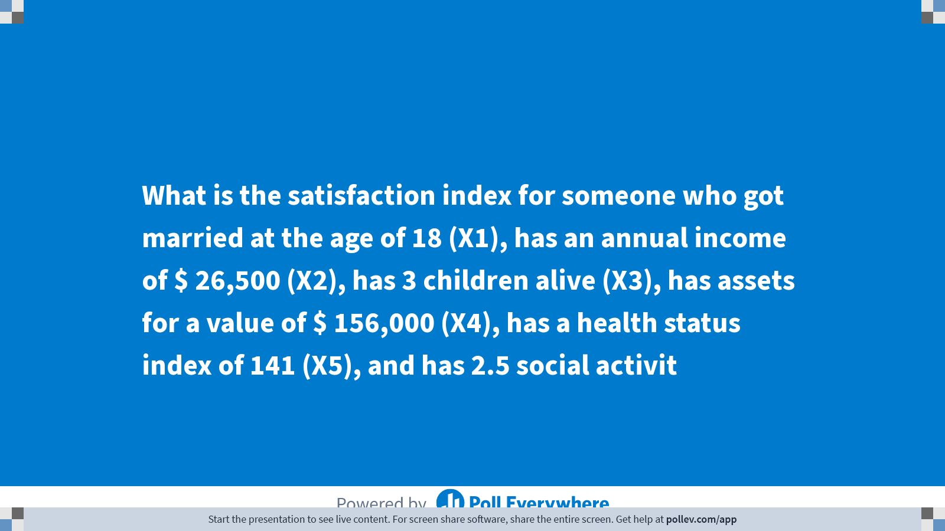
Notes:
Poll Title: Do not modify the notes in this section to avoid tampering with the Poll Everywhere activity. More info at polleverywhere.com/support What is the satisfaction index for someone who got married at the age of 18 (X1), has an annual income of $ 26,500 (X2), has 3 children alive (X3), has assets for a value of $ 156,000 (X4), has a health status index of 141 (X5), and has 2.5 social activit https://www.polleverywhere.com/multiple_choice_polls/skRHecTACGLCtqmSXwLMa?display_state=title&controls=none&onscreen=persist

Slide 27
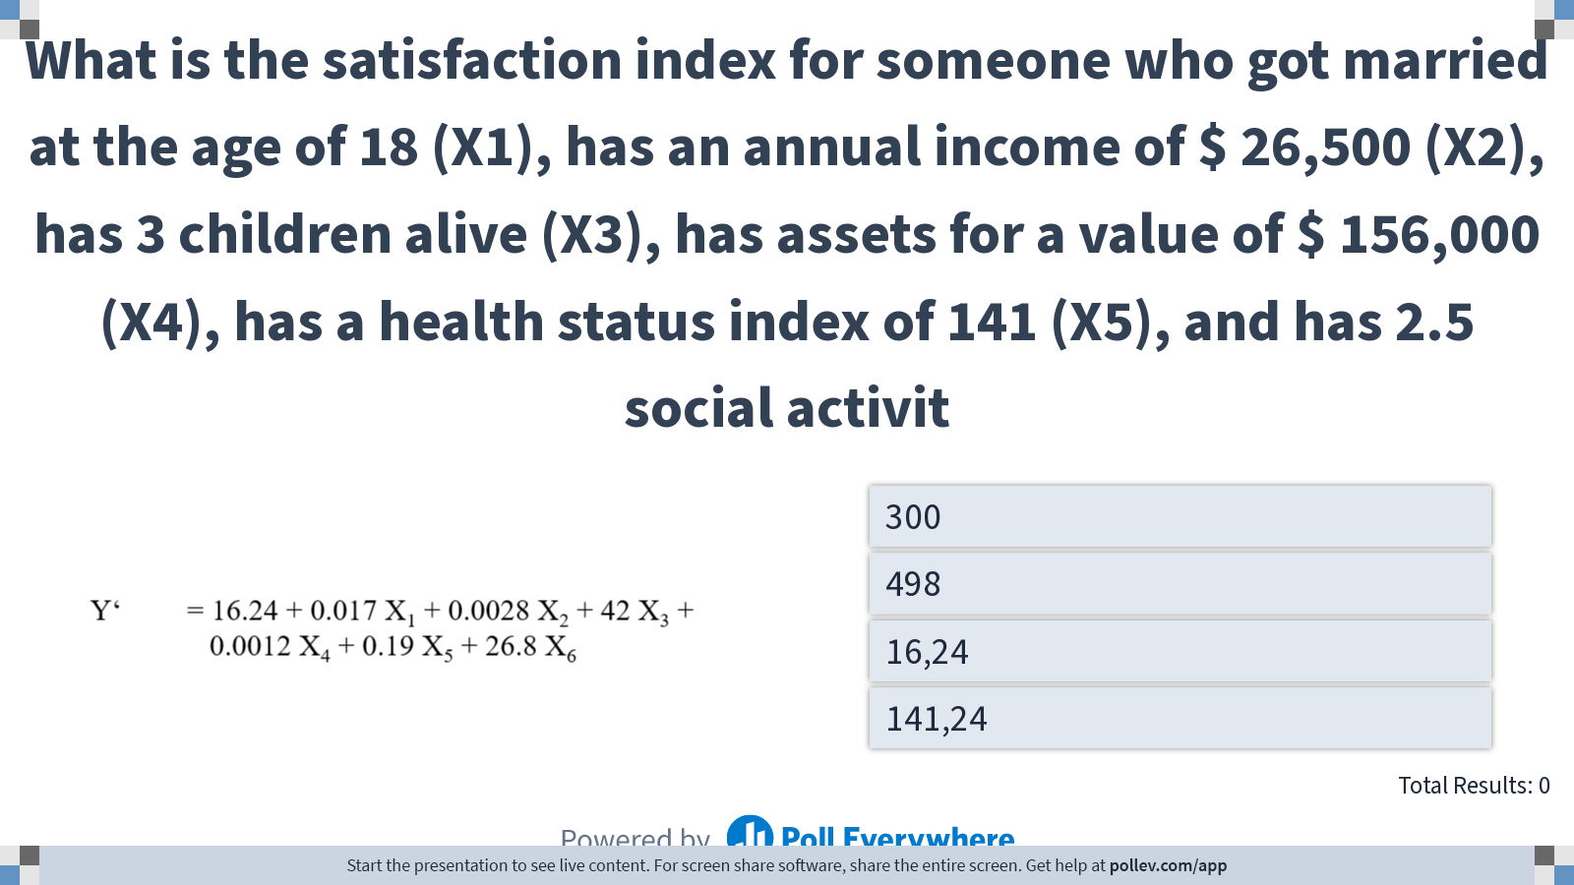
Notes:
Poll Title: Do not modify the notes in this section to avoid tampering with the Poll Everywhere activity. More info at polleverywhere.com/support What is the satisfaction index for someone who got married at the age of 18 (X1), has an annual income of $ 26,500 (X2), has 3 children alive (X3), has assets for a value of $ 156,000 (X4), has a health status index of 141 (X5), and has 2.5 social activit https://www.polleverywhere.com/multiple_choice_polls/skRHecTACGLCtqmSXwLMa?display_state=instructions&controls=none&onscreen=persist

Slide 28
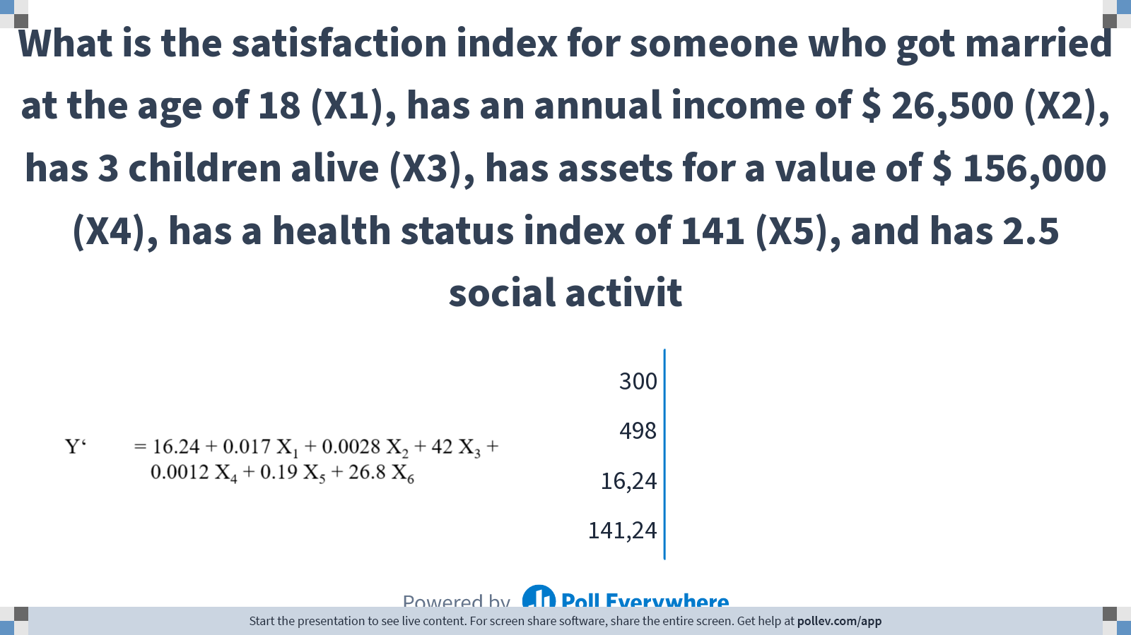
Notes:
Poll Title: Do not modify the notes in this section to avoid tampering with the Poll Everywhere activity. More info at polleverywhere.com/support What is the satisfaction index for someone who got married at the age of 18 (X1), has an annual income of $ 26,500 (X2), has 3 children alive (X3), has assets for a value of $ 156,000 (X4), has a health status index of 141 (X5), and has 2.5 social activit https://www.polleverywhere.com/multiple_choice_polls/skRHecTACGLCtqmSXwLMa?display_state=chart&display=correctness&controls=none&onscreen=persist

Slide 29
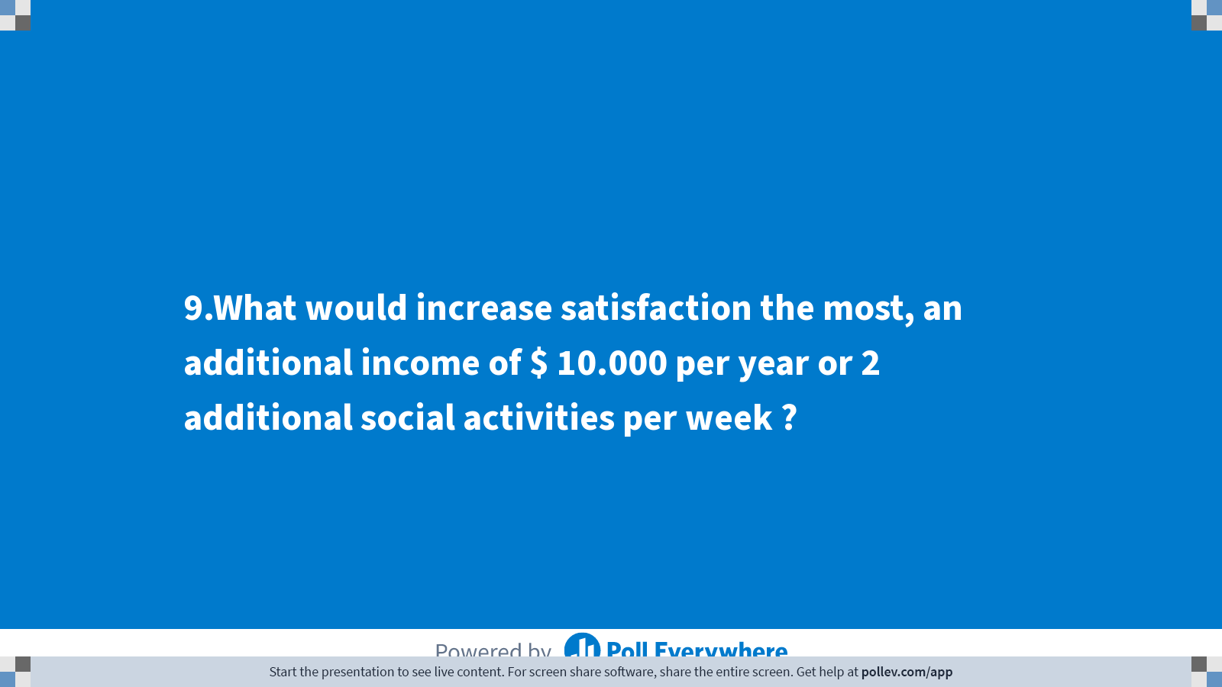
Notes:
Poll Title: Do not modify the notes in this section to avoid tampering with the Poll Everywhere activity. More info at polleverywhere.com/support 9.What would increase satisfaction the most, an additional income of $ 10.000 per year or 2 additional social activities per week ? https://www.polleverywhere.com/multiple_choice_polls/E974B7ofy7wyc7xkTmwKn?display_state=title&controls=none&onscreen=persist

Slide 30
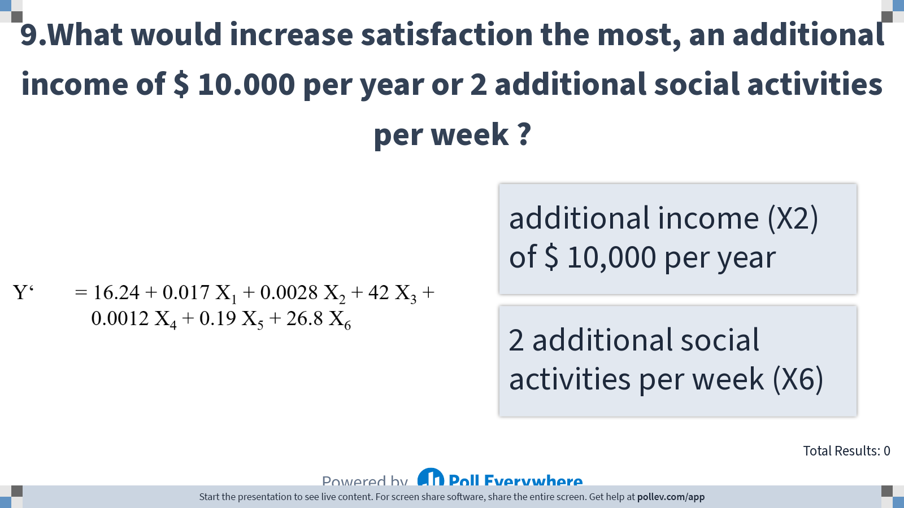
Notes:
Poll Title: Do not modify the notes in this section to avoid tampering with the Poll Everywhere activity. More info at polleverywhere.com/support 9.What would increase satisfaction the most, an additional income of $ 10.000 per year or 2 additional social activities per week ? https://www.polleverywhere.com/multiple_choice_polls/E974B7ofy7wyc7xkTmwKn?display_state=instructions&controls=none&onscreen=persist

Slide 31
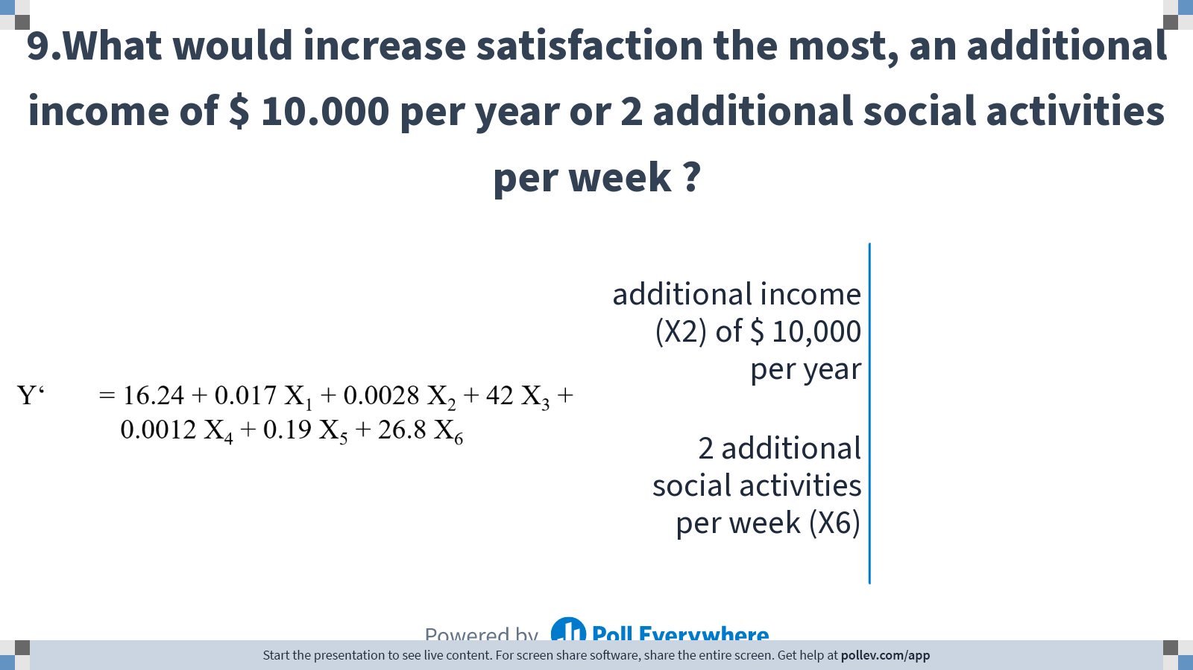
Notes:
Poll Title: Do not modify the notes in this section to avoid tampering with the Poll Everywhere activity. More info at polleverywhere.com/support 9.What would increase satisfaction the most, an additional income of $ 10.000 per year or 2 additional social activities per week ? https://www.polleverywhere.com/multiple_choice_polls/E974B7ofy7wyc7xkTmwKn?display_state=chart&display=correctness&controls=none&onscreen=persist

Slide 32
The plot below is a scatterplot of residuals against independent variable (age) in a study investigating the relation between age and happiness.

Slide 33
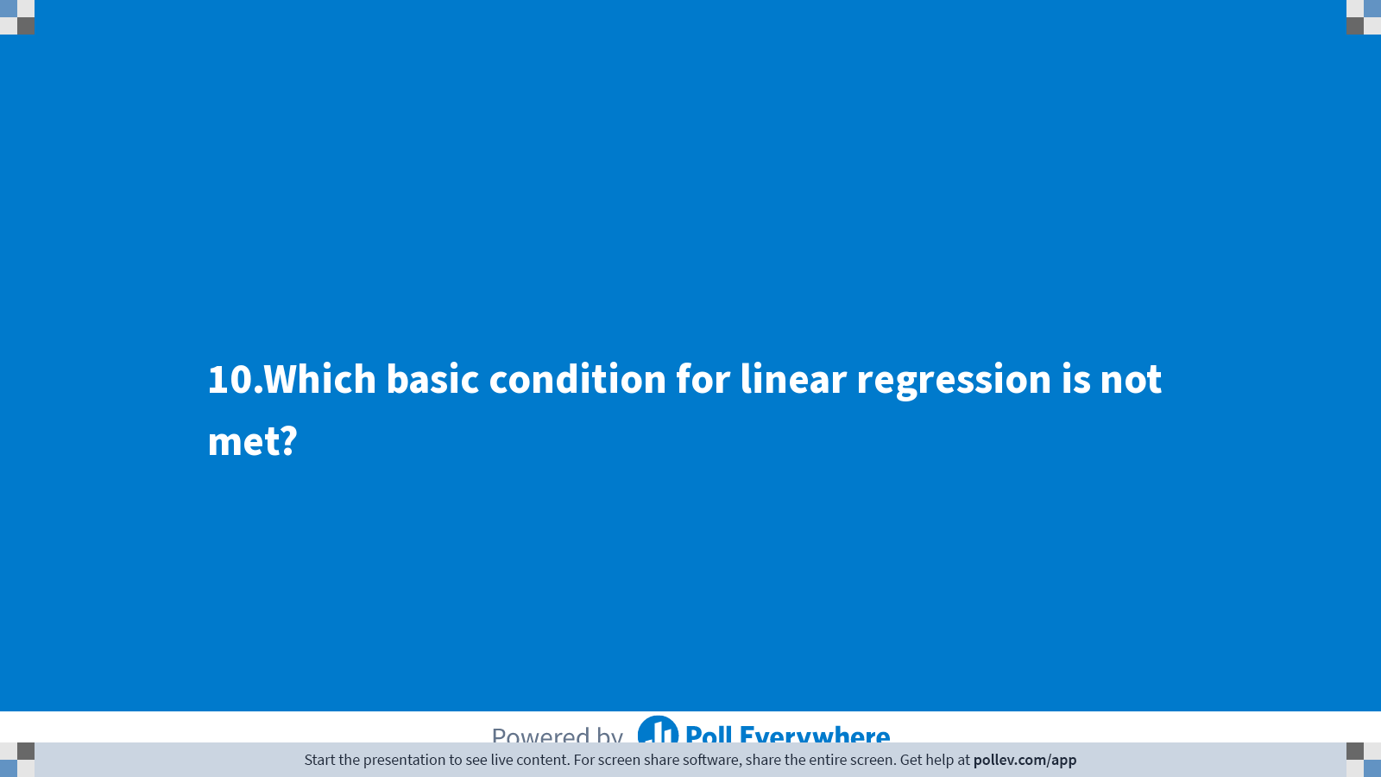
Notes:
Poll Title: Do not modify the notes in this section to avoid tampering with the Poll Everywhere activity. More info at polleverywhere.com/support 10.Which basic condition for linear regression is not met? https://www.polleverywhere.com/multiple_choice_polls/nTDouD80qcLEwsy1pZEmm?display_state=title&controls=none&onscreen=persist

Slide 34
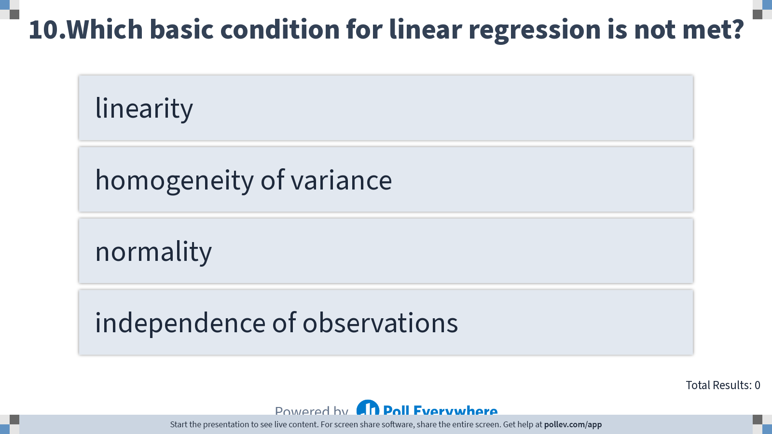
Notes:
Poll Title: Do not modify the notes in this section to avoid tampering with the Poll Everywhere activity. More info at polleverywhere.com/support 10.Which basic condition for linear regression is not met? https://www.polleverywhere.com/multiple_choice_polls/nTDouD80qcLEwsy1pZEmm?display_state=instructions&controls=none&onscreen=persist

Slide 35
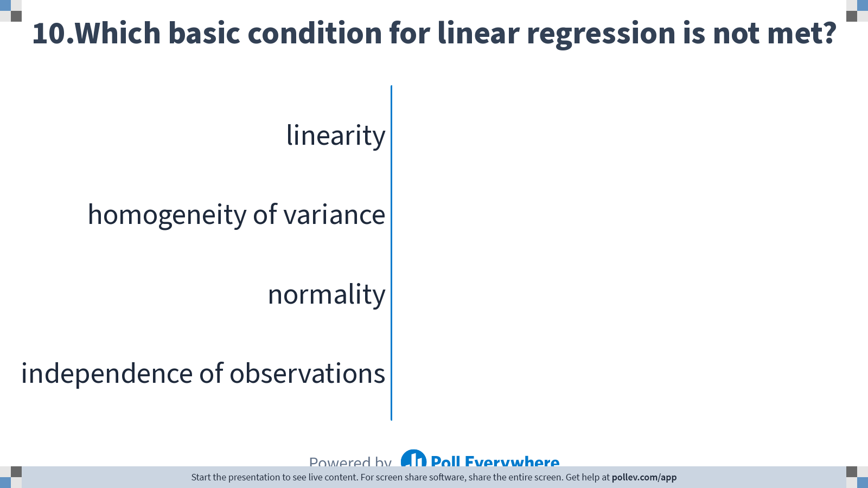
Notes:
Poll Title: Do not modify the notes in this section to avoid tampering with the Poll Everywhere activity. More info at polleverywhere.com/support 10.Which basic condition for linear regression is not met? https://www.polleverywhere.com/multiple_choice_polls/nTDouD80qcLEwsy1pZEmm?display_state=chart&display=correctness&controls=none&onscreen=persist

Slide 36
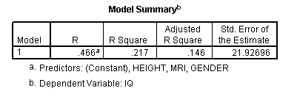
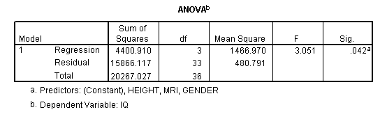
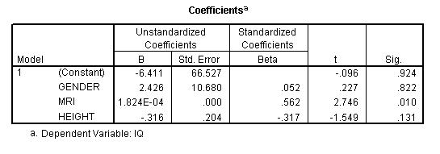
Article: We study the relation between IQ (IQ points), brain size (MRI pixels), length (cm) and sex (0=m, 1=f).
SPSS output:

Slide 37
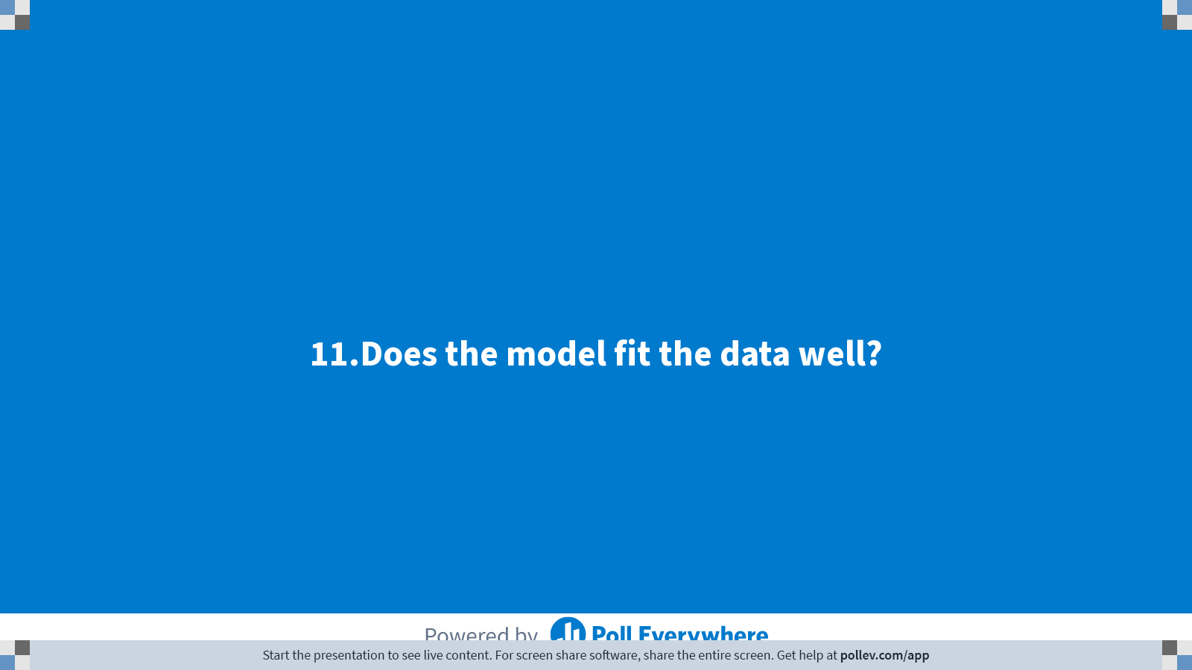
Notes:
Poll Title: Do not modify the notes in this section to avoid tampering with the Poll Everywhere activity. More info at polleverywhere.com/support 11.Does the model fit the data well? https://www.polleverywhere.com/multiple_choice_polls/jZGmLywEm96UYWaVTBtSl?display_state=title&controls=none&onscreen=persist

Slide 38
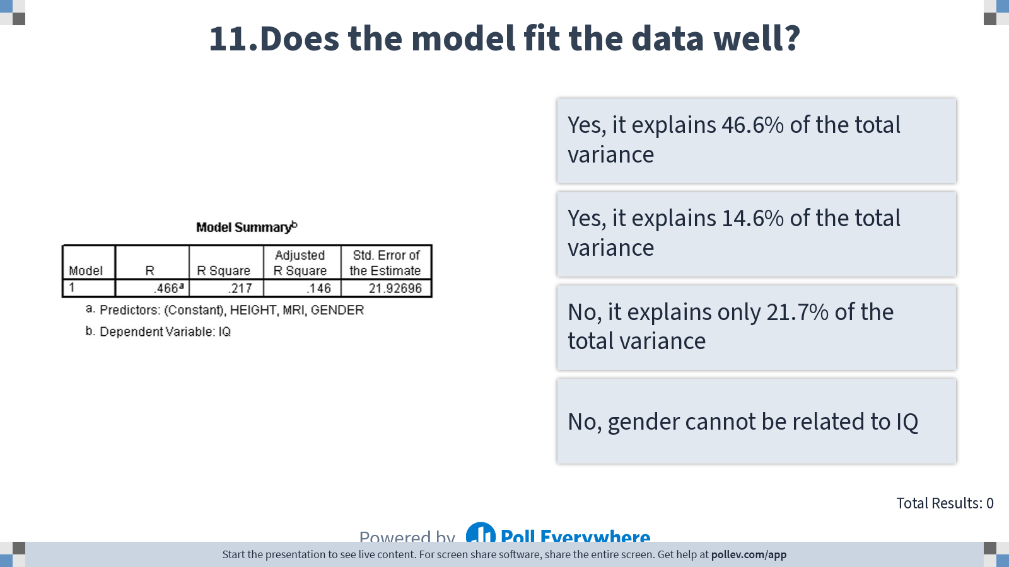
Notes:
Poll Title: Do not modify the notes in this section to avoid tampering with the Poll Everywhere activity. More info at polleverywhere.com/support 11.Does the model fit the data well? https://www.polleverywhere.com/multiple_choice_polls/jZGmLywEm96UYWaVTBtSl?display_state=instructions&controls=none&onscreen=persist

Slide 39
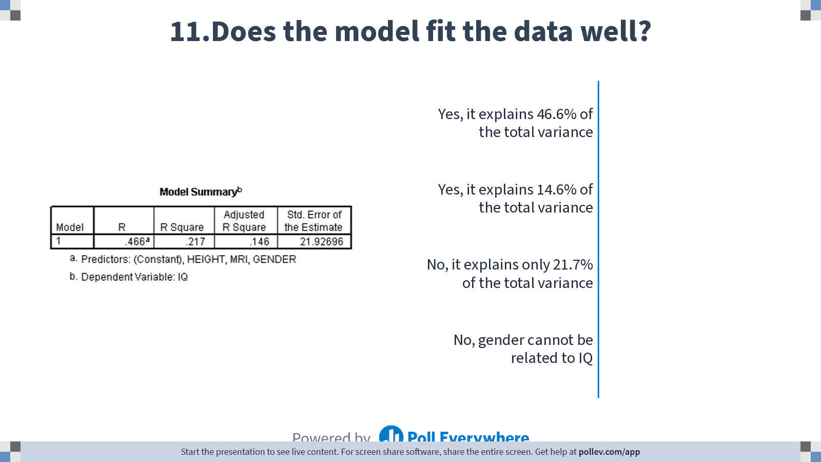
Notes:
Poll Title: Do not modify the notes in this section to avoid tampering with the Poll Everywhere activity. More info at polleverywhere.com/support 11.Does the model fit the data well? https://www.polleverywhere.com/multiple_choice_polls/jZGmLywEm96UYWaVTBtSl?display_state=chart&display=correctness&controls=none&onscreen=persist

Slide 40
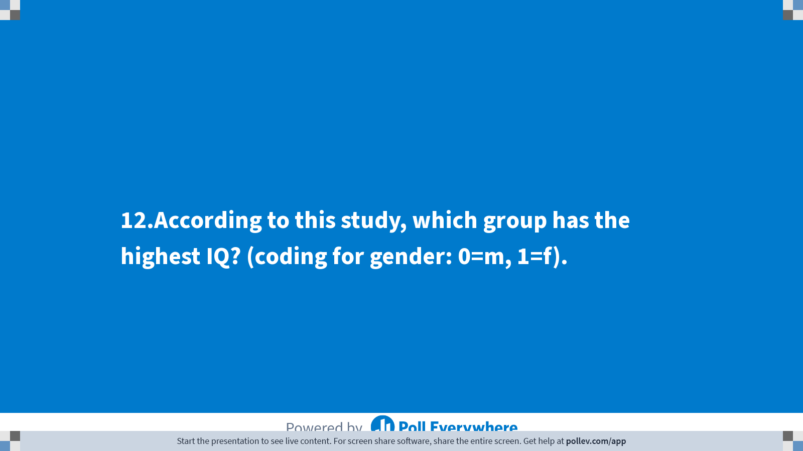
Notes:
Poll Title: Do not modify the notes in this section to avoid tampering with the Poll Everywhere activity. More info at polleverywhere.com/support 12.According to this study, which group has the highest IQ? (coding for gender: 0=m, 1=f). https://www.polleverywhere.com/multiple_choice_polls/OHrY3HY1GAJYAAUykcLNm?display_state=title&controls=none&onscreen=persist

Slide 41
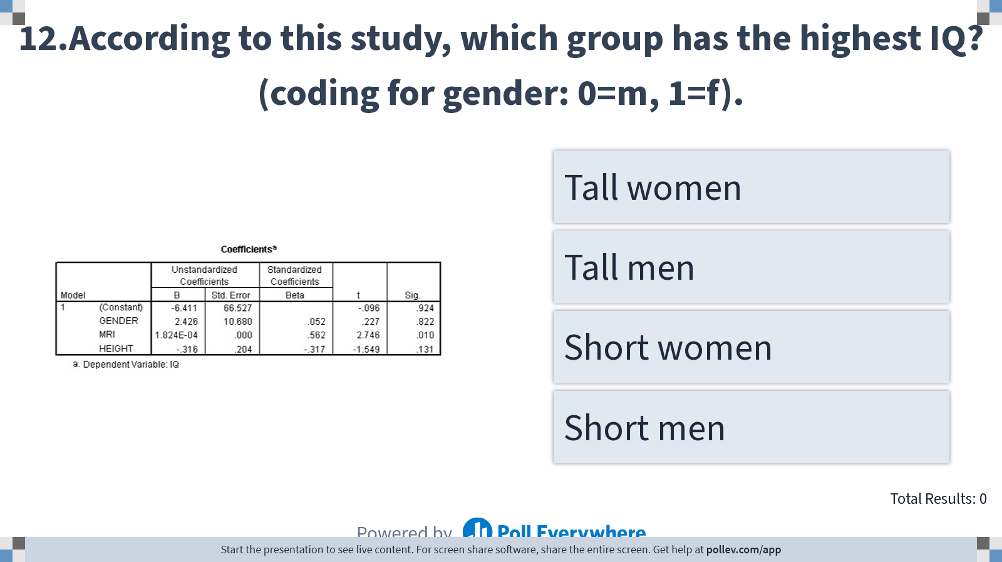
Notes:
Poll Title: Do not modify the notes in this section to avoid tampering with the Poll Everywhere activity. More info at polleverywhere.com/support 12.According to this study, which group has the highest IQ? (coding for gender: 0=m, 1=f). https://www.polleverywhere.com/multiple_choice_polls/OHrY3HY1GAJYAAUykcLNm?display_state=instructions&controls=none&onscreen=persist

Slide 42
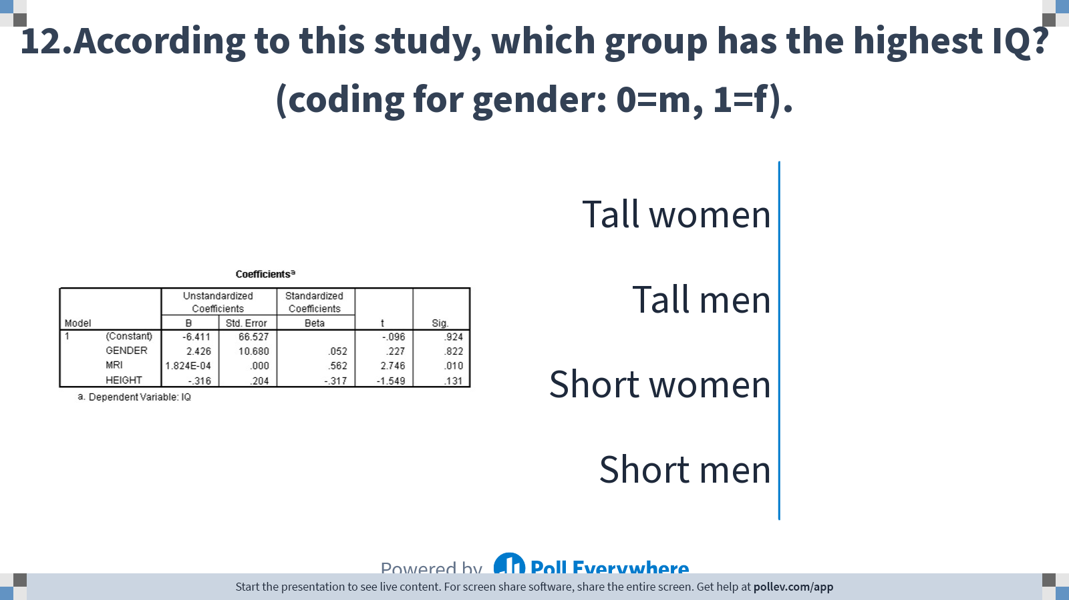
Notes:
Poll Title: Do not modify the notes in this section to avoid tampering with the Poll Everywhere activity. More info at polleverywhere.com/support 12.According to this study, which group has the highest IQ? (coding for gender: 0=m, 1=f). https://www.polleverywhere.com/multiple_choice_polls/OHrY3HY1GAJYAAUykcLNm?display_state=chart&display=correctness&controls=none&onscreen=persist

Slide 43
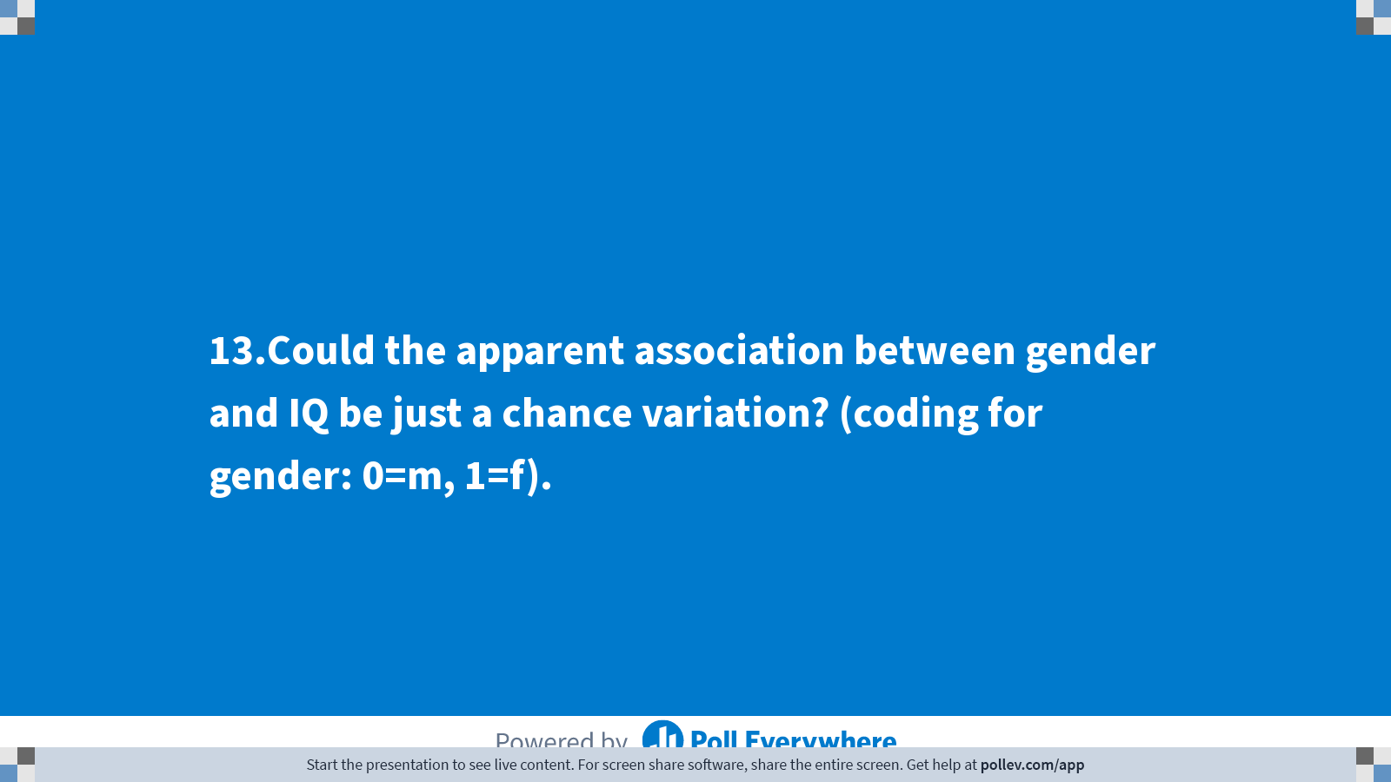
Notes:
Poll Title: Do not modify the notes in this section to avoid tampering with the Poll Everywhere activity. More info at polleverywhere.com/support 13.Could the apparent association between gender and IQ be just a chance variation? (coding for gender: 0=m, 1=f). https://www.polleverywhere.com/multiple_choice_polls/swidfb6xIQmBXGbJhFJTv?display_state=title&controls=none&onscreen=persist

Slide 44
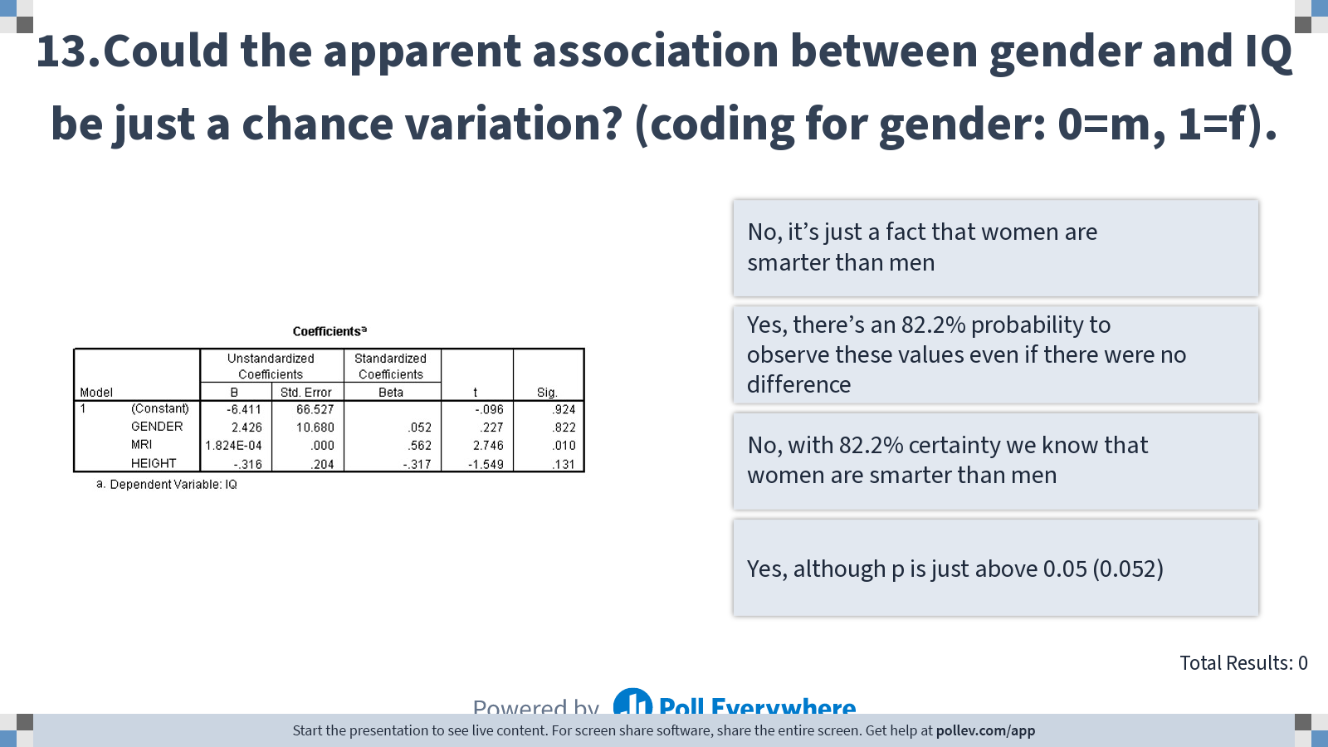
Notes:
Poll Title: Do not modify the notes in this section to avoid tampering with the Poll Everywhere activity. More info at polleverywhere.com/support 13.Could the apparent association between gender and IQ be just a chance variation? (coding for gender: 0=m, 1=f). https://www.polleverywhere.com/multiple_choice_polls/swidfb6xIQmBXGbJhFJTv?display_state=instructions&controls=none&onscreen=persist

Slide 45
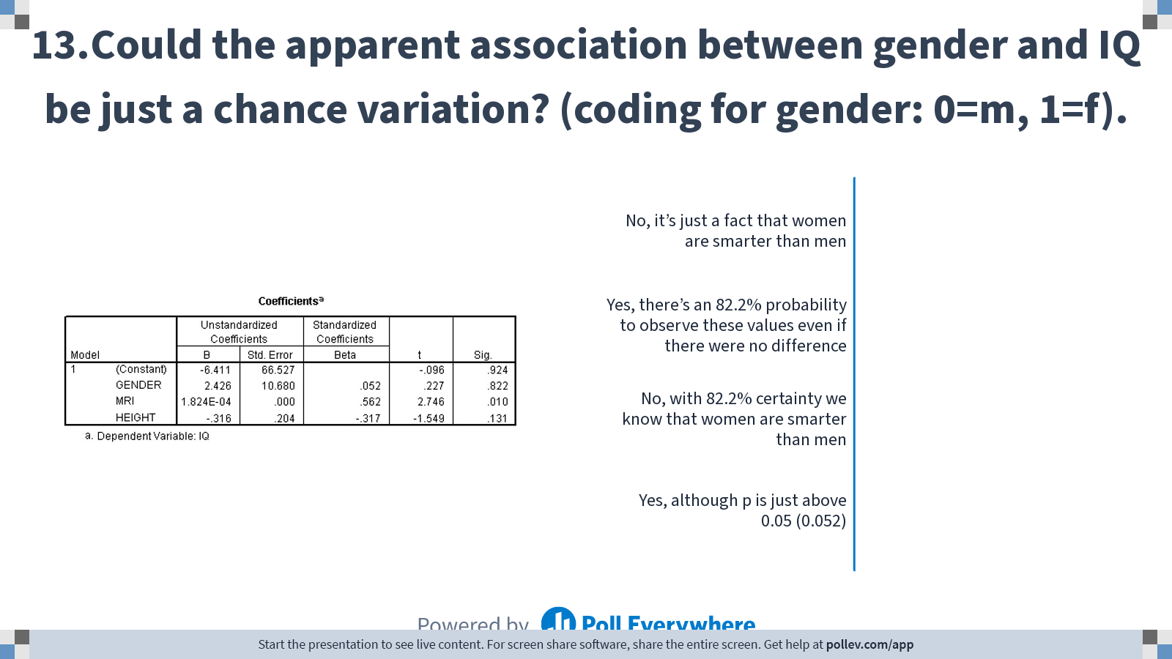
Notes:
Poll Title: Do not modify the notes in this section to avoid tampering with the Poll Everywhere activity. More info at polleverywhere.com/support 13.Could the apparent association between gender and IQ be just a chance variation? (coding for gender: 0=m, 1=f). https://www.polleverywhere.com/multiple_choice_polls/swidfb6xIQmBXGbJhFJTv?display_state=chart&display=correctness&controls=none&onscreen=persist

Slide 46
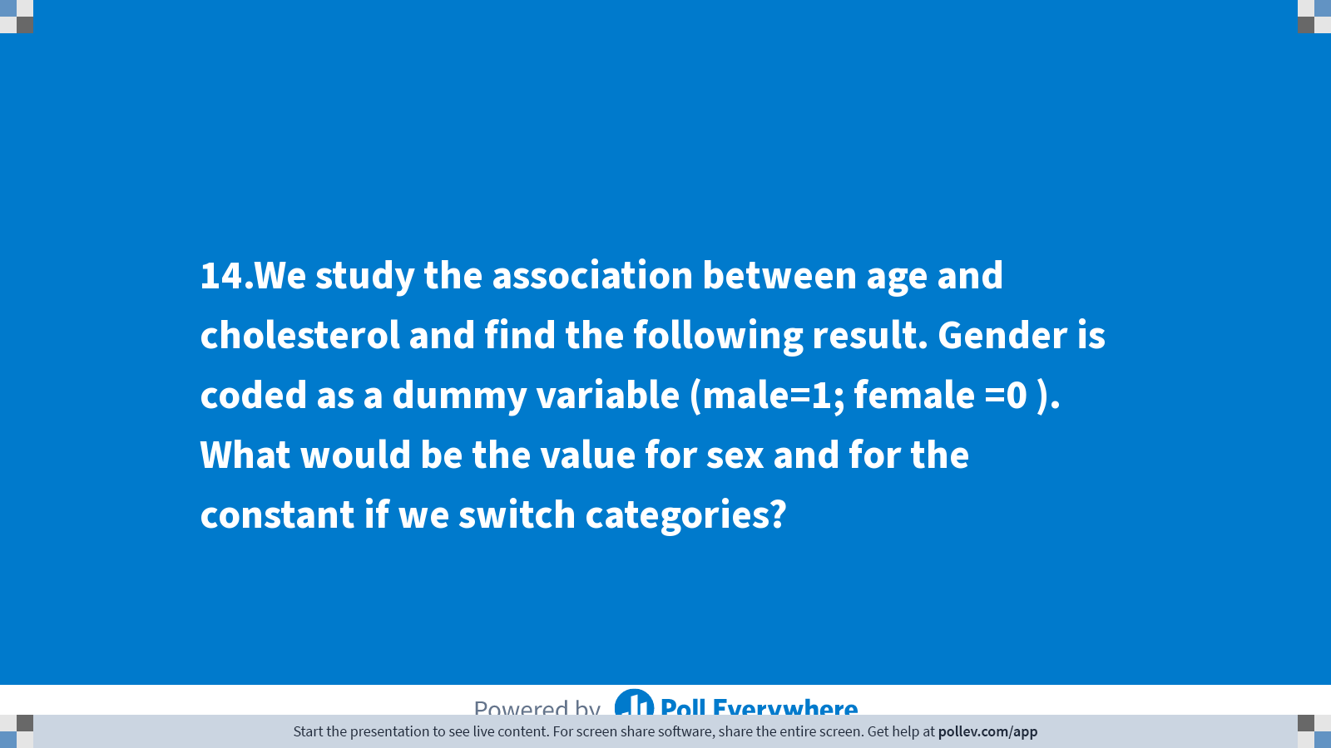
Notes:
Poll Title: Do not modify the notes in this section to avoid tampering with the Poll Everywhere activity. More info at polleverywhere.com/support 14.We study the association between age and cholesterol and find the following result. Gender is coded as a dummy variable (male=1; female =0 ). What would be the value for sex and for the constant if we switch categories? https://www.polleverywhere.com/multiple_choice_polls/tEQpjX1lhx4op18rIkNel?display_state=title&controls=none&onscreen=persist

Slide 47
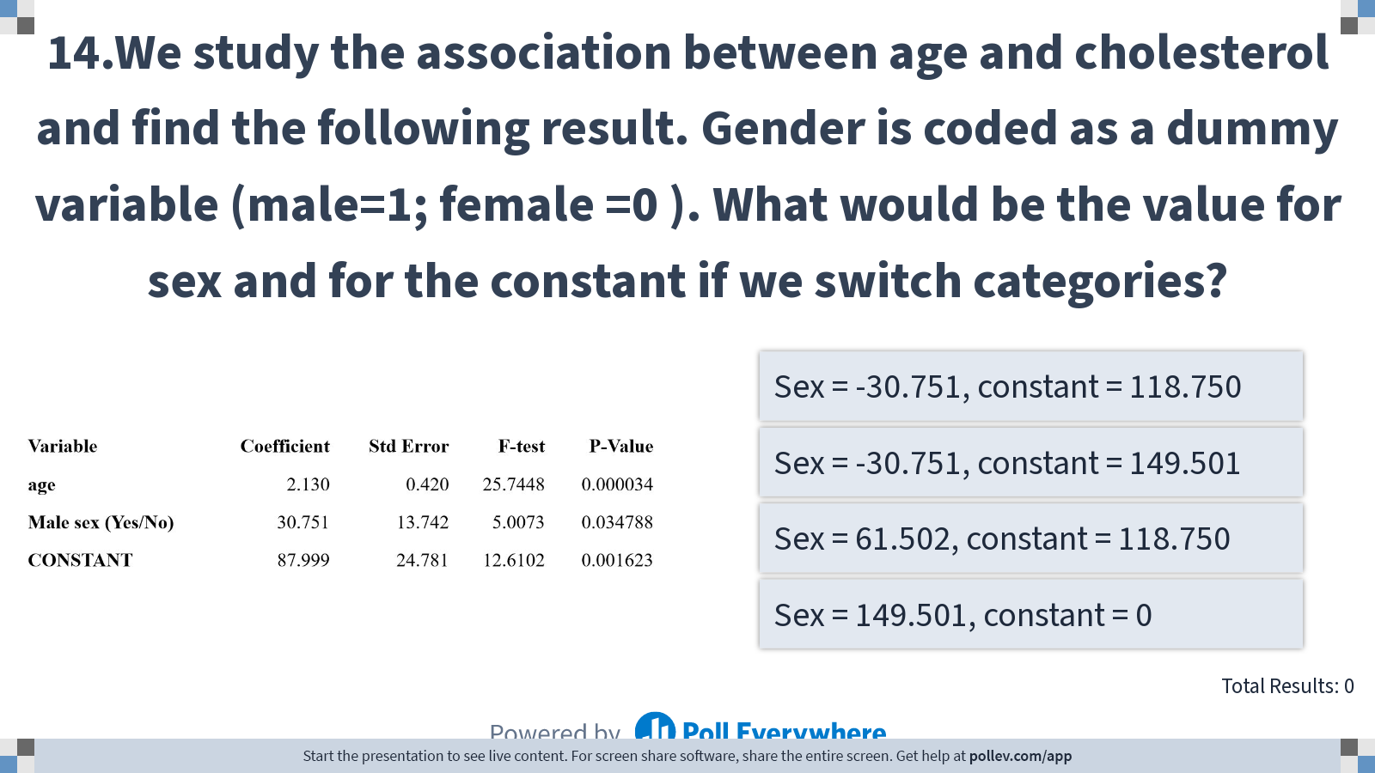
Notes:
Poll Title: Do not modify the notes in this section to avoid tampering with the Poll Everywhere activity. More info at polleverywhere.com/support 14.We study the association between age and cholesterol and find the following result. Gender is coded as a dummy variable (male=1; female =0 ). What would be the value for sex and for the constant if we switch categories? https://www.polleverywhere.com/multiple_choice_polls/tEQpjX1lhx4op18rIkNel?display_state=instructions&controls=none&onscreen=persist

Slide 48
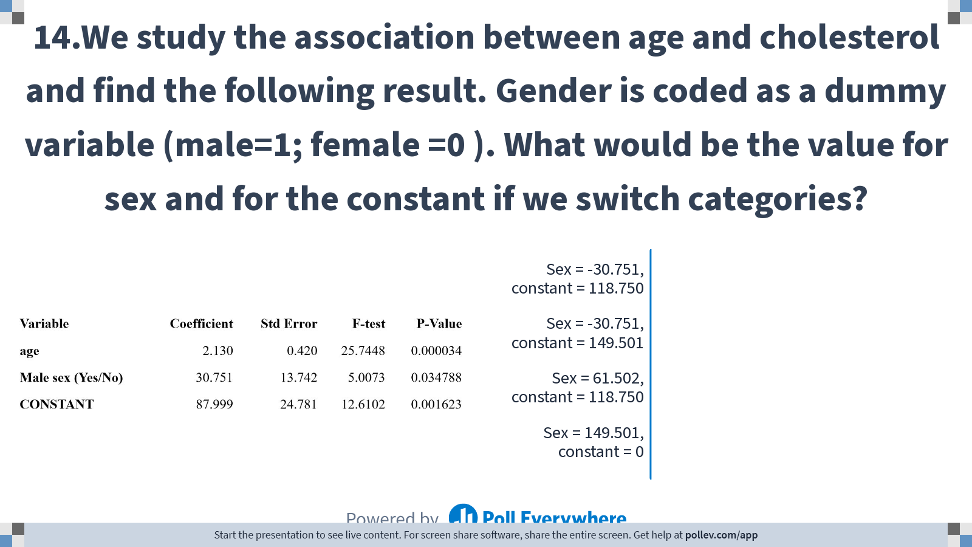
Notes:
Poll Title: Do not modify the notes in this section to avoid tampering with the Poll Everywhere activity. More info at polleverywhere.com/support 14.We study the association between age and cholesterol and find the following result. Gender is coded as a dummy variable (male=1; female =0 ). What would be the value for sex and for the constant if we switch categories? https://www.polleverywhere.com/multiple_choice_polls/tEQpjX1lhx4op18rIkNel?display_state=chart&display=correctness&controls=none&onscreen=persist

Slide 49
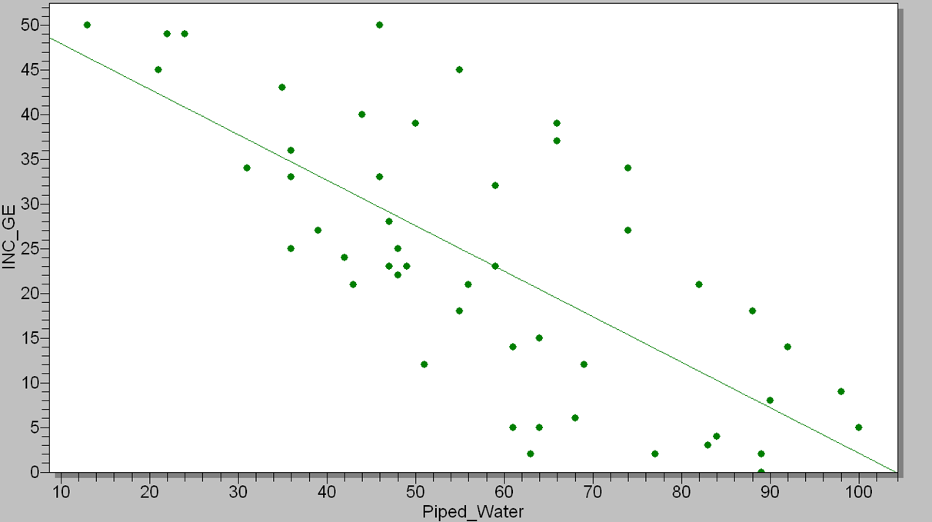
The graph below shows the association between incidence of diarrhoea and the proportion of households with access to piped water in different neigborhoods of a city. Two different models were fitted to explain the association observed.

Slide 50
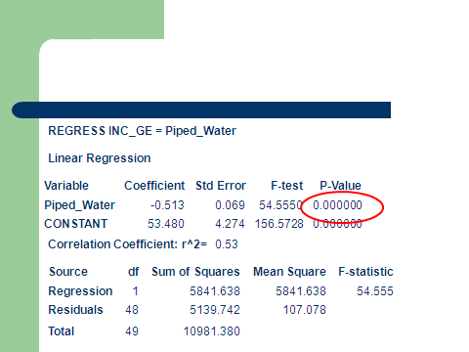
Model 1: Piped water only

Slide 51

Model 2: Piped water and mean number of microbes per ml in drinking water of each neighborhood

Slide 52

Notes:
Poll Title: Do not modify the notes in this section to avoid tampering with the Poll Everywhere activity. More info at polleverywhere.com/support 15.Which of the following statements is correct? https://www.polleverywhere.com/multiple_choice_polls/l49ige5GPKMbXU8fdBWi6?display_state=title&controls=none&onscreen=persist

Slide 53

Notes:
Poll Title: Do not modify the notes in this section to avoid tampering with the Poll Everywhere activity. More info at polleverywhere.com/support 15.Which of the following statements is correct? https://www.polleverywhere.com/multiple_choice_polls/l49ige5GPKMbXU8fdBWi6?display_state=instructions&controls=none&onscreen=persist

Slide 54

Notes:
Poll Title: Do not modify the notes in this section to avoid tampering with the Poll Everywhere activity. More info at polleverywhere.com/support 15.Which of the following statements is correct? https://www.polleverywhere.com/multiple_choice_polls/l49ige5GPKMbXU8fdBWi6?display_state=chart&display=correctness&controls=none&onscreen=persist

Slide 55


How the number of human births varies with stork populations in 17 European countries.
Source: Teaching Statistics. Volume 22, Number 2, Summer 2000

Slide 56

Notes:
Poll Title: Do not modify the notes in this section to avoid tampering with the Poll Everywhere activity. More info at polleverywhere.com/support 16.Which of the statements below is correct? https://www.polleverywhere.com/multiple_choice_polls/uIq0b6UFhmmI3h7Qz6AqY?display_state=title&controls=none&onscreen=persist

Slide 57

Notes:
Poll Title: Do not modify the notes in this section to avoid tampering with the Poll Everywhere activity. More info at polleverywhere.com/support 16.Which of the statements below is correct? https://www.polleverywhere.com/multiple_choice_polls/uIq0b6UFhmmI3h7Qz6AqY?display_state=instructions&controls=none&onscreen=persist

Slide 58

Notes:
Poll Title: Do not modify the notes in this section to avoid tampering with the Poll Everywhere activity. More info at polleverywhere.com/support 16.Which of the statements below is correct? https://www.polleverywhere.com/multiple_choice_polls/uIq0b6UFhmmI3h7Qz6AqY?display_state=chart&display=correctness&controls=none&onscreen=persist

Slide 59

Notes:
Poll Title: Do not modify the notes in this section to avoid tampering with the Poll Everywhere activity. More info at polleverywhere.com/support 17.How much will be the predicted cholesterol level for an 80-year old Nebraskan? https://www.polleverywhere.com/multiple_choice_polls/i4GFHyMGDfOFBNJCdXh9D?display_state=title&controls=none&onscreen=persist

Slide 60

Notes:
Poll Title: Do not modify the notes in this section to avoid tampering with the Poll Everywhere activity. More info at polleverywhere.com/support 17.How much will be the predicted cholesterol level for an 80-year old Nebraskan? https://www.polleverywhere.com/multiple_choice_polls/i4GFHyMGDfOFBNJCdXh9D?display_state=instructions&controls=none&onscreen=persist

Slide 61

Notes:
Poll Title: Do not modify the notes in this section to avoid tampering with the Poll Everywhere activity. More info at polleverywhere.com/support 17.How much will be the predicted cholesterol level for an 80-year old Nebraskan? https://www.polleverywhere.com/multiple_choice_polls/i4GFHyMGDfOFBNJCdXh9D?display_state=chart&display=correctness&controls=none&onscreen=persist

Slide 62
Psychologists study the relation between sleep deprivation and intellectual performance among students. Twenty-eight volunteers are submitted to different periods of sleep deprivation, and subsequently have to respond to mental arithmetic questions.
Here are the results:

Slide 63

Notes:
Poll Title: Do not modify the notes in this section to avoid tampering with the Poll Everywhere activity. More info at polleverywhere.com/support 18.In the report, the relation is described as follows: 'MISTAKES'' = 3.4 + 0.73 'NO SLEEP'. What does this mean? https://www.polleverywhere.com/multiple_choice_polls/g1Vi9GYocZjmcekvXVhm5?display_state=title&controls=none&onscreen=persist

Slide 64

Notes:
Poll Title: Do not modify the notes in this section to avoid tampering with the Poll Everywhere activity. More info at polleverywhere.com/support 18.In the report, the relation is described as follows: 'MISTAKES'' = 3.4 + 0.73 'NO SLEEP'. What does this mean? https://www.polleverywhere.com/multiple_choice_polls/g1Vi9GYocZjmcekvXVhm5?display_state=instructions&controls=none&onscreen=persist

Slide 65

Notes:
Poll Title: Do not modify the notes in this section to avoid tampering with the Poll Everywhere activity. More info at polleverywhere.com/support 18.In the report, the relation is described as follows: 'MISTAKES'' = 3.4 + 0.73 'NO SLEEP'. What does this mean? https://www.polleverywhere.com/multiple_choice_polls/g1Vi9GYocZjmcekvXVhm5?display_state=chart&display=correctness&controls=none&onscreen=persist

Slide 66

Notes:
Poll Title: Do not modify the notes in this section to avoid tampering with the Poll Everywhere activity. More info at polleverywhere.com/support 19.The report mentions r² = 0,88. This means: https://www.polleverywhere.com/multiple_choice_polls/zNVYcull7STLG3IqrTH5u?display_state=title&controls=none&onscreen=persist

Slide 67

Notes:
Poll Title: Do not modify the notes in this section to avoid tampering with the Poll Everywhere activity. More info at polleverywhere.com/support 19.The report mentions r² = 0,88. This means: https://www.polleverywhere.com/multiple_choice_polls/zNVYcull7STLG3IqrTH5u?display_state=instructions&controls=none&onscreen=persist

Slide 68

Notes:
Poll Title: Do not modify the notes in this section to avoid tampering with the Poll Everywhere activity. More info at polleverywhere.com/support 19.The report mentions r² = 0,88. This means: https://www.polleverywhere.com/multiple_choice_polls/zNVYcull7STLG3IqrTH5u?display_state=chart&display=correctness&controls=none&onscreen=persist

Slide 69

Notes:
Poll Title: Do not modify the notes in this section to avoid tampering with the Poll Everywhere activity. More info at polleverywhere.com/support 20.How many km a car with a weight of 1000 kg can drive on 1 liter of 98 octane fuel? https://www.polleverywhere.com/multiple_choice_polls/2q07A4g5xPtPCzZtLwBfq?display_state=title&controls=none&onscreen=persist

Slide 70

Notes:
Poll Title: Do not modify the notes in this section to avoid tampering with the Poll Everywhere activity. More info at polleverywhere.com/support 20.How many km a car with a weight of 1000 kg can drive on 1 liter of 98 octane fuel? https://www.polleverywhere.com/multiple_choice_polls/2q07A4g5xPtPCzZtLwBfq?display_state=instructions&controls=none&onscreen=persist

Slide 71

Notes:
Poll Title: Do not modify the notes in this section to avoid tampering with the Poll Everywhere activity. More info at polleverywhere.com/support 20.How many km a car with a weight of 1000 kg can drive on 1 liter of 98 octane fuel? https://www.polleverywhere.com/multiple_choice_polls/2q07A4g5xPtPCzZtLwBfq?display_state=chart&display=correctness&controls=none&onscreen=persist

Slide 72

Notes:
Poll Title: Do not modify the notes in this section to avoid tampering with the Poll Everywhere activity. More info at polleverywhere.com/support Linear Regression https://www.polleverywhere.com/competitions/ll7dAKhMNsDwXB9Bsk5zY?display_state=finale&onscreen=persist

